Slide 1
Python Programming

Slide 2
Python
Goals
Modules Basics
Design Pattern
Rest API best practices
Microservice using Django in depth

Slide 3

Python’s Benevolent Dictator For Life
“Guido van Rossum

Slide 4
Python Basics
⭐ 1. What is Python?
Python is a high-level, interpreted, general-purpose programming language.
Key characteristics
Interpreted → runs line-by-line (no compilation step).
Dynamically typed → variables do not need type declarations.
High-level → closer to human language.
Object-oriented → everything in Python is an object.
Cross-platform → runs on Windows/Linux/macOS.
Huge ecosystem → NumPy, Pandas, Django, Flask, TensorFlow, etc.

Slide 5
Python Basics
⭐ 2. Python Execution Model
🔹 Interpreter Flow
You write code → .py file
Python converts code → bytecode (.pyc)
Python Virtual Machine (PVM) executes bytecode
Results shown
Python does not create machine code directly like C/C++.

Slide 6
🧩 PYTHON MEMORY MANAGEMENT
Python memory handling is done through:
Memory Architecture
Reference Counting
Garbage Collection (GC)
Pointers and Object Model
Stack vs Heap
Memory Pools / Allocators (PyMalloc)
Interning

Slide 7
🧩 PYTHON MEMORY MANAGEMENT
Python memory handling is done through:
Memory Architecture
Reference Counting
Garbage Collection (GC)
Pointers and Object Model
Stack vs Heap
Memory Pools / Allocators (PyMalloc)
Interning

Slide 8
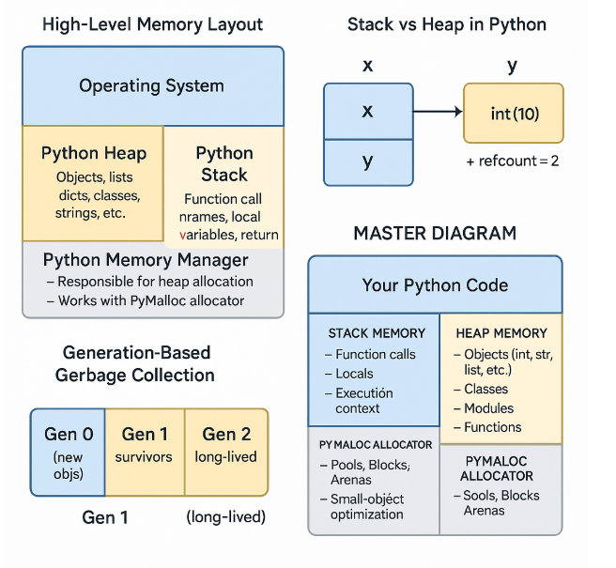
🧱 1. Python Memory Architecture

Slide 9
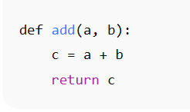
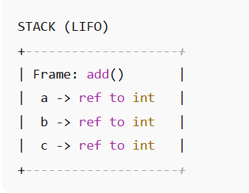
🧱 2. Stack vs Heap in Python
🔹 Stack Memory
Used for:
Function call frames
Local variables (but they only store references)

Slide 10
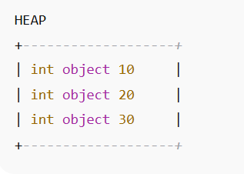
🧱 2. Stack vs Heap in Python
🔹 Heap Memory
Where the actual objects live

Slide 11
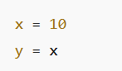
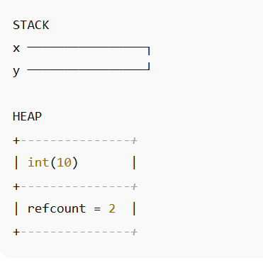
🧱 3. Python Objects & Pointers
Every Python variable is just a pointer/reference to an object in the heap.

Slide 12
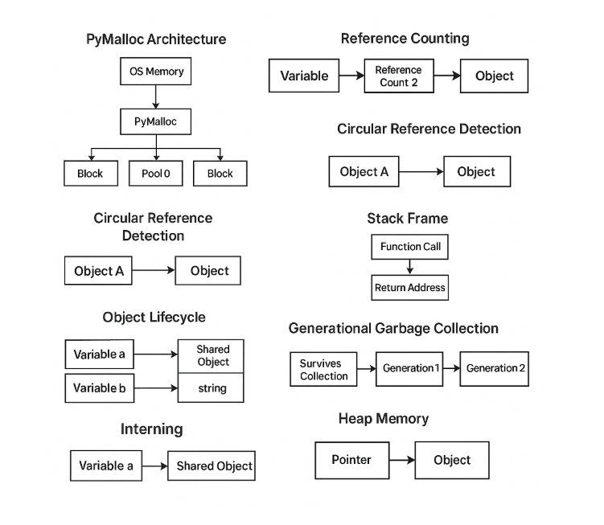
🧱 2. All Python Memory Management Diagrams

Slide 13
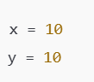
🧱 3. Python Objects & Pointers
Why refcount = 2?
Python interns small integers (from –5 to 256). So, the value 10 exists once in memory, and both variables x and y point to the same object.
So, Python keeps:
Object: 10
Reference count: 2 <-- because x and y point here

Slide 14
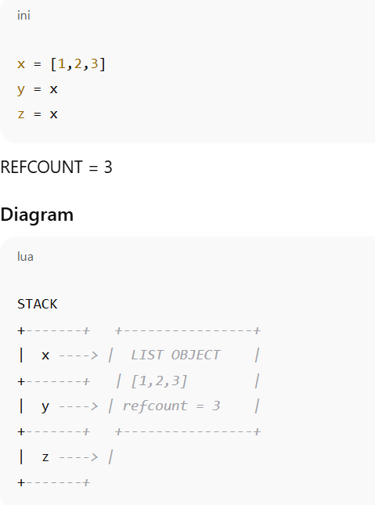
🧮 4. Reference Counting (CORE of CPython)
Every object has a refcount: “How many references are pointing to me?”

Slide 15
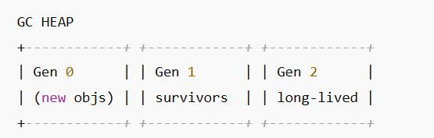
🪣 5. Garbage Collection — Generation Based
Python has three generations of garbage.
WHY?
Most objects die young → optimize cleanup.
Generations:
Gen0 → youngest (frequently collected)
Gen1
Gen2 → oldest (rarely collected)

Slide 16
♻️ 6. How Python Determines What to Delete
Two phases:
1️⃣ Reference counting
Immediate deletion when refcount = 0
2️⃣ Cycle Detection
For objects referencing each other (common in lists, classes)

Slide 17
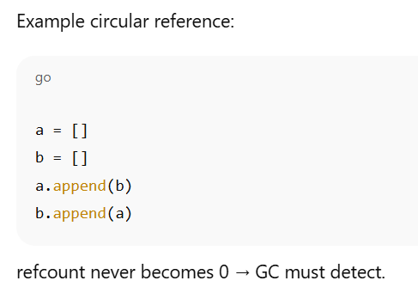
♻️ 6. How Python Determines What to Delete

Slide 18
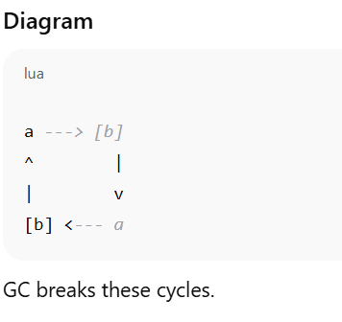
♻️ 6. How Python Determines What to Delete

Slide 19
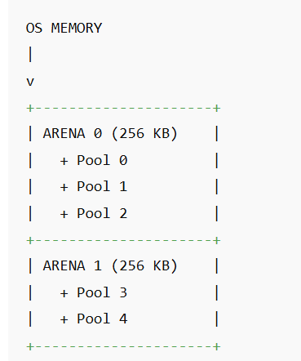
🧱 7. PyMalloc — Python's Memory Allocator
Python does NOT use OS malloc() for every object.
It uses:
PyMalloc for small objects
Blocks: 8 KB
Pools of 64-byte classes
Arenas (256 KB)
This makes Python memory fast, cached, reusable.

Slide 20
🧱 7. PyMalloc — Python's Memory Allocator
Python does NOT use OS malloc() for every object.
It uses:
PyMalloc for small objects
Blocks: 8 KB
Pools of 64-byte classes
Arenas (256 KB)

Slide 21
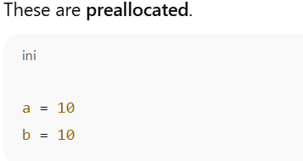
🧠 8. Small Object Optimization / Interning
Python optimizes memory by reusing objects for:
🔹 Small integers (between -5 to 256)
These are preallocated.

Slide 22
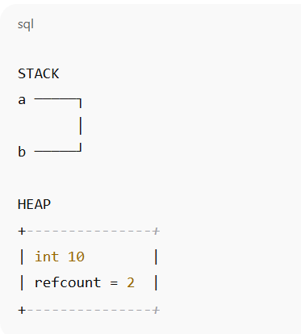
🧠 8. Small Object Optimization / Interning
🔹 String interning
Common strings reused:
identifiers
small strings
compile-time constants

Slide 23
🧊 9. Memory Leaks in Python (Yes, they happen)
Situations causing leaks:
Global variables holding references
Circular references with __del__
Large objects kept in caches
Unclosed file handles
Third-party C-extensions

Slide 24
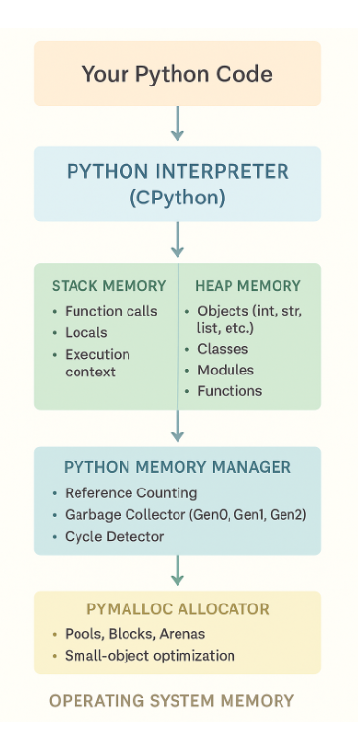
🧬 10. Putting It All Together (MASTER DIAGRAM)

Slide 25
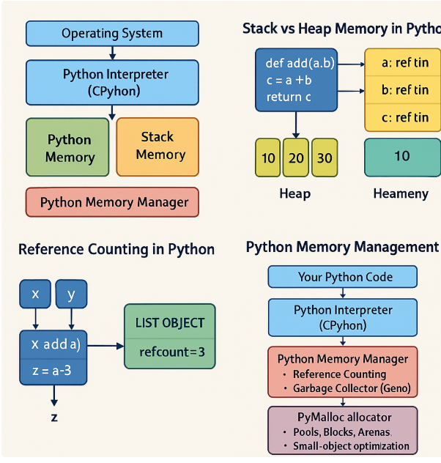
🧱 All Python Memory Management Diagrams

Slide 26
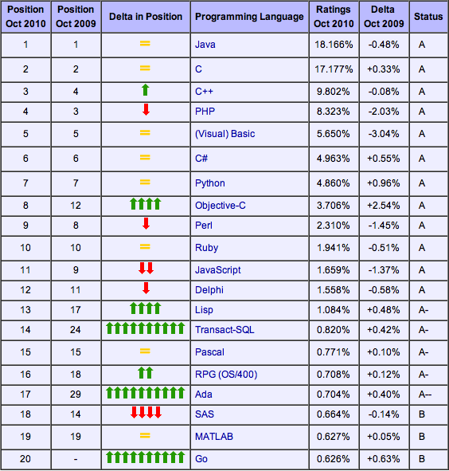
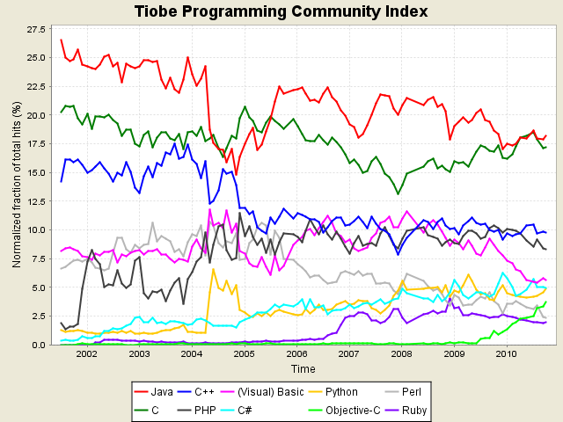
Python’s place in the Market
TIOBE has been collecting data on programming language “popularity” for many years
Counts results for a query like "<language> programming” on popular search engines
10/10 TIOBE Programming Community Index

Slide 27
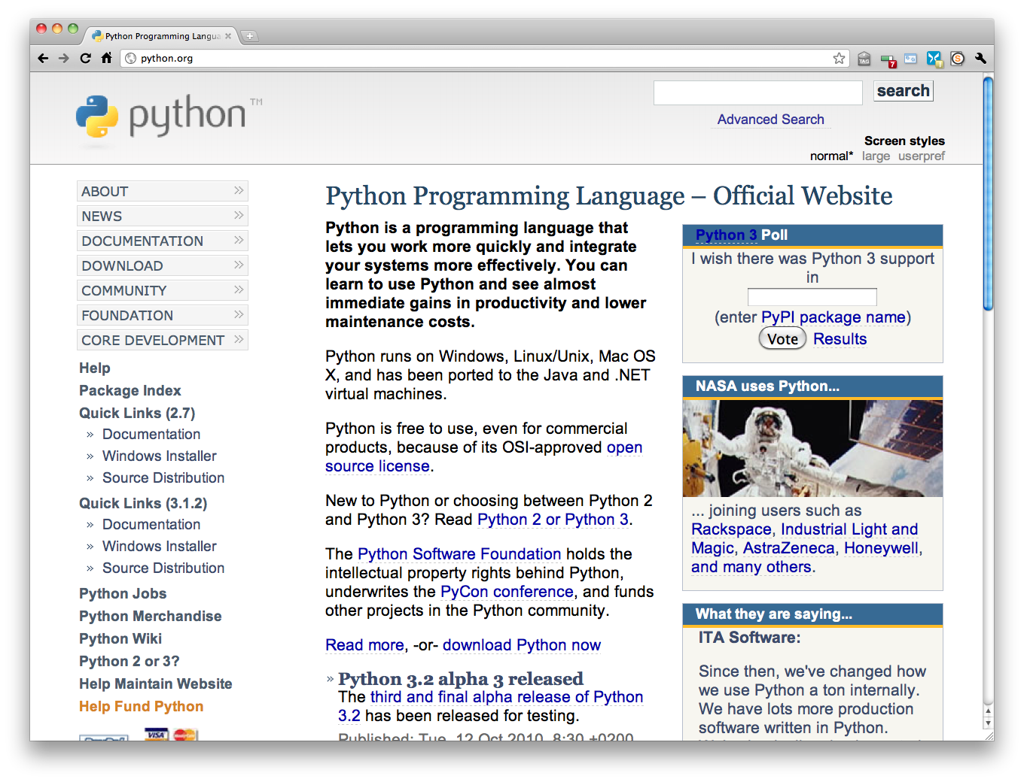
http://python.org/

Slide 28
Why Python?
1️⃣ Super easy to read & write
Python’s whole vibe is: 👉 “Let me not torture you.”
You can learn the syntax in a weekend and still build serious apps.
for item in items:
print(item)
That’s it. No ceremony. No boilerplate.

Slide 29
Why Python?
2️⃣ Massive ecosystem — libraries for everything
Python is like a supermarket where every shelf is full.
Want AI? → TensorFlow, PyTorch Data analysis? → Pandas, NumPy Web apps? → Django, Flask, FastAPI Automation? → Selenium, PyAutoGUI APIs? → FastAPI, Flask Machine learning? → Scikit-Learn DevOps? → Ansible, Fabric Visualization? → Matplotlib, Seaborn, Plotly
Whatever you want to build, someone already created a Python library for it.

Slide 30
Why Python?
3️⃣ Perfect for beginners & experts
Beginners love it because it’s simple. Experts love it because it’s powerful. That balance is rare.

Slide 31
Why Python?
4️⃣ Python is everywhere
Industries using it right now:
AI & Machine Learning
Data Science
Finance & Banking
Automation / DevOps
Web Development
Cybersecurity
IoT
Scientific Computing
Python isn’t a “nice to have” — it's a golden ticket skill.

Slide 32
Why Python?
5️⃣ Huge community & support
If you get stuck, someone else has already solved that problem.
StackOverflow alone is overflowing with Python answers. Libraries have great documentation. You will never feel alone in Python.

Slide 33
Why Python?
6️⃣ Cross-platform
Write once → run anywhere.
Windows, macOS, Linux, Raspberry Pi, cloud VMs — Python doesn’t care.

Slide 34
Why Python?
7️⃣ Ideal for rapid development
You can prototype insanely fast.
Business loves Python because:
Faster prototypes → faster feedback → faster delivery
Less code → fewer bugs → cheaper maintenance

Slide 35
Why Python?
8️⃣ It plays well with others
Python integrates with:
C / C++
Java
Rust
SQL databases
Cloud services
REST APIs
Microservices
It’s like that friendly coworker who gets along with everybody.

Slide 36
Why Python?
9️⃣ Perfect for automation & scripting
If you want your computer to do your boring work:
Rename files
Read Excel sheets
Automate browser clicks
Run DevOps tasks
Create cron jobs
Python is literally the king of automation.

Slide 37
Why Python?
🔟 Strong job market
Python is consistently in the top 3 globally for:
Most in-demand skill
Highest paying tech roles
Most used languages
Most loved by developers

Slide 38
Why Python?
🔟 Strong job market
Python developers work in:
Google
Netflix
Amazon
NASA
JP Morgan
Meta
Infosys, TCS, Accenture
Every AI startup EVER

Slide 39
Python Is Free and Open Source
Open source: Publicly available; open-source software typically programmed by volunteers; anyone can use source code without fee
Can modify or even resell Python
Embracing open-source ideals is part of what makes Python successful

Slide 40
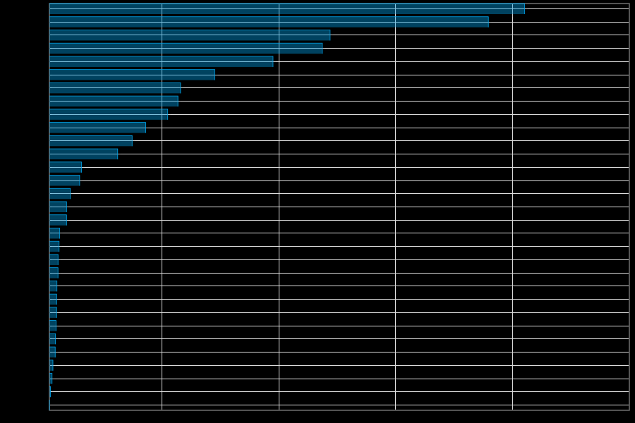
Python is Popular
All those advantages make Python a commonly used (and liked) language (http://www.langpop.com/):
Java
C
C++
Javascript
PHP
Python………
SQL
Perl
C#

Slide 41
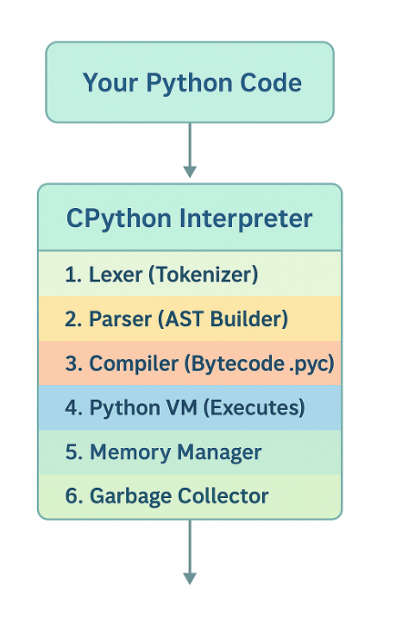
The Python Interpreter

Slide 42
The Python Interpreter
The Python interpreter is the software that:
1️⃣ Reads your Python code 2️⃣ Converts it into something the computer can understand 3️⃣ Executes it step-by-step
The most widely used interpreter is CPython, the official one written in C.

Slide 43
The Python Interpreter
🔥 How the Python Interpreter Works (The Full Pipeline)
When you run:
python app.py
The interpreter does all this:

Slide 44
The Python Interpreter
1️⃣ Lexing / Tokenization
Your code → split into tokens (keywords, identifiers, numbers, operators)
Example:
x = 10 + 5
Tokens:
NAME(x), EQUAL, NUMBER(10), PLUS, NUMBER(5)

Slide 45
The Python Interpreter
2️⃣ Parsing
Tokens → syntax tree (AST)
Python checks:
is the syntax valid?
do commas, brackets, indentation all match?
Example AST snippet:
Assign
├── Name(x)
└── BinOp(10 + 5)

Slide 46
The Python Interpreter
3️⃣ Compilation to Bytecode
Python compiles the AST into bytecode (low-level instructions).
This creates .pyc files inside __pycache__/ directory.
Bytecode example:
LOAD_CONST 10
LOAD_CONST 5
BINARY_ADD
STORE_NAME x

Slide 47
The Python Interpreter
4️⃣ Execution by the Python Virtual Machine (PVM)
The bytecode runs inside the PVM — a loop that executes opcode by opcode.
Think of it like:
while True:
instruction = get_next_bytecode()
execute(instruction)
That’s literally what the interpreter does behind the scenes.

Slide 48
The Python Interpreter
⭐ Where Does the Interpreter Live?
The interpreter includes:
✔ Parser
✔ Compiler
✔ Bytecode VM
✔ Memory Manager
✔ Garbage Collector
✔ Standard Library Loader
✔ Built-in object model

Slide 49
🧠 What CPython Really Is
CPython = Python language implementation in C.
It provides:
C API (PyObject*)
GIL (Global Interpreter Lock)
Reference counting
PyMalloc memory allocator
CPython powers 99% of Python installations.

Slide 50
⚡ Other Python Interpreters (Not Just One!)
Python has multiple implementations:
🟦 CPython
→ Default, official, fastest to maintain → Written in C → Has the GIL
🟩 PyPy
→ Super fast, uses JIT (Just-In-Time compilation) → Great for long-running programs

Slide 51
⚡ Other Python Interpreters (Not Just One!)
🟪 Jython
→ Runs on JVM → Integrates with Java libraries
🟧 IronPython
→ Runs on .NET CLR → Integrates with C# libraries
⬛ MicroPython
→ For microcontrollers (ESP32, Arduino, etc.)

Slide 52
What is the Python Interpreter?
It is the engine that:
✔ Reads your code ✔ Translates it to bytecode ✔ Runs that bytecode on a virtual machine ✔ Manages memory & garbage collection ✔ Handles errors, imports, objects, functions
It's the “brain” of Python.

Slide 53
Installing
✅ 1. Install Python on Windows
Step 1 — Download
Go to the official site:
👉 https://www.python.org/downloads/
Click “Download Python 3.x.x”

Slide 54
Installing
Step 2 — RUN the Installer
VERY IMPORTANT: ✔️ Check the box: “Add Python to PATH”
Then click: → Install Now

Slide 55
Installing
Step 3 — Verify Installation
Open CMD and type:
python --version

Slide 56
🏗️ 4. Create a Virtual Environment (Recommended)
This keeps project packages separate.
python3 -m venv myenv
Activate:
Windows
myenv\Scripts\activate
macOS/Linux
source myenv/bin/activate

Slide 57
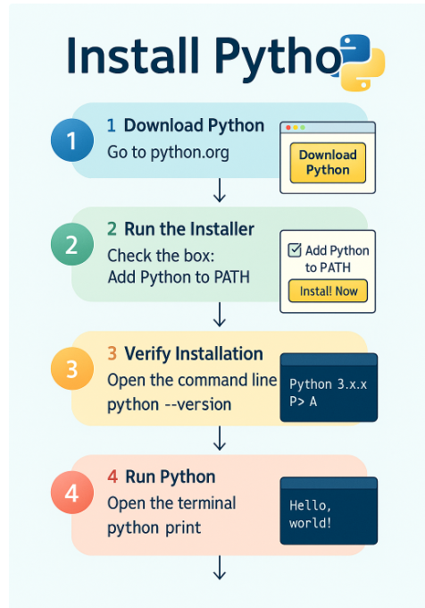
Python IDEs and Shells

Slide 58
What Are Identifiers in Python?
An identifier is simply the name you give to things in Python:
variables
functions
classes
modules
packages
constants
objects
Basically — anything you name is an identifier.

Slide 59
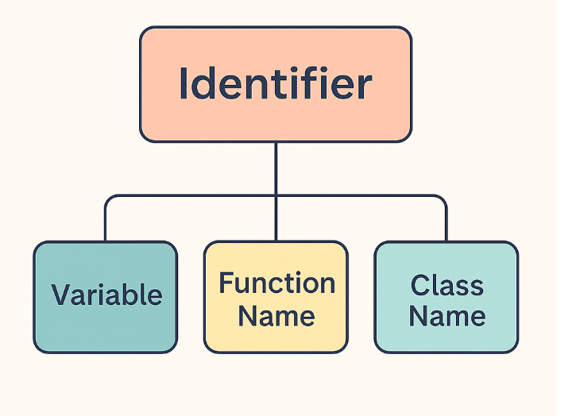
What Are Identifiers in Python?

Slide 60
What Are Identifiers in Python?
name = "Alice" # 'name' is an identifier
def greet(): # 'greet' is an identifier
pass
class Car: # 'Car' is an identifier
pass

Slide 61
Rules for Writing Identifiers
✔️ 1. Identifiers can contain:
Letters (a–z, A–Z)
Digits (0–9)
Underscore _
count1
_user_name
age2

Slide 62
Rules for Writing Identifiers
❌ 2. Identifiers cannot start with a digit
🚫 Invalid:
1value = 10
✔️ Valid:
value1 = 10

Slide 63
Rules for Writing Identifiers
✔️ 3. Identifiers are case-sensitive
Age = 10
age = 20
These are two different variables.

Slide 64
Rules for Writing Identifiers
❌ 4. You cannot use Python keywords as identifiers
Keywords like:
if, while, return, class, def, pass, break, continue, True, False, None
🚫 Invalid:
class = 10
✔️ Valid:
class_name = 10

Slide 65
Rules for Writing Identifiers
✔️ 5. Identifiers can be of any length
Python does not limit length (but keep them readable).

Slide 66
⭐ Best Practices for Identifiers (Recommended)
✔️ Use meaningful names
total_marks = 90 # Good
tm = 90 # Bad
✔️ Follow Python naming conventions (PEP 8)
Variables & functions
→ snake_case
user_name
calculate_total()
Constants
→ UPPERCASE
MAX_SPEED = 120

Slide 67
⭐ Valid vs Invalid Identifier Examples
✔️ Valid identifiers
x
value123
_my_var
first_name
MAX_VALUE
get_data

Slide 68
⭐ Valid vs Invalid Identifier Examples
❌ Invalid identifiers
1name
first-name
total%value
class # keyword
for # keyword

Slide 69
⭐ Valid vs Invalid Identifier Examples
⭐ Special Identifiers (Python Internals)
You will notice strange names like:
__init__
__str__
__main__
These are dunder identifiers (“double underscore”) and they are used internally by Python.
Example:
__init__ → constructor method __str__ → string representation __main__ → entry point script

Slide 70
Identifier naming convention for Python
Class names start with an uppercase letter and all other identifiers with a lowercase letter.
Starting an identifier with a single leading underscore indicates by convention that the identifier is meant to be private.
Starting an identifier with two leading underscores indicates a strongly private identifier.
If the identifier also ends with two trailing underscores, the identifier is a language-defined special name.

Slide 71
🟦 1. _variable (Single Leading Underscore)
A name that starts with one underscore → _name is a weak internal-use indicator.
✔ Meaning:
“This is private. Don’t use it outside the module/class.”
Python does NOT enforce privacy — it’s only a convention, not a rule.
✔ Example:
class Demo:
def __init__(self):
self._internal_value = 100

Slide 72
🟦 1. _variable (Single Leading Underscore)
Developers understand that:
_internal_value is not part of public API
It may change at any time
✔ Used for:
Internal variables
Temporary variables
Non-public methods
Example in modules:
_var = 10 # treated as internal

Slide 73
2. __main__ (Double Leading & Trailing Underscores)
This is a special Python identifier (called a dunder).
__main__ refers to:
✔ The top-level script being executed
OR
✔ The name of the current module when directly run
When you run:
python myscript.py
Inside that file:
__name__ == "__main__"
So, Python knows:
This file is being run directly
Not imported as a module

Slide 74
2. __main__ (Double Leading & Trailing Underscores)
🧠 Use Case: The Famous if __name__ == "__main__":
def run():
print("Running script...")
if __name__ == "__main__":
run()
This block only runs when the file is executed directly.
If the same file is imported:
import myscript
run() will NOT run automatically, because:
myscript.__name__ = "myscript"

Slide 75
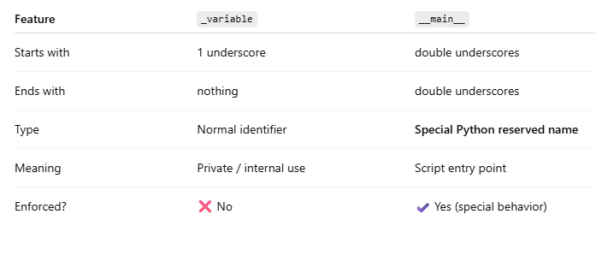
🟦 _variable vs 🟥 __main__ (Side-by-Side Comparison)

Slide 76
__main__
Since there is no main() function in Python, when the command to run a python program is given to the interpreter, the code that is at level 0 indentation is to be executed.
Will define a few special variables. __name__ is one such special variable.
If the source file is executed as the main program, the interpreter sets the __name__ variable to have a value “__main__”.
If this file is being imported from another module, __name__ will be set to the module’s name.
__name__ is a built-in variable which evaluates to the name of the current module.

Slide 77
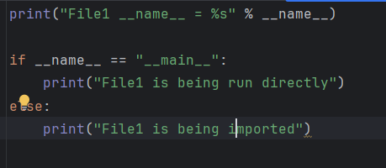
__main__

Slide 78
Reserved Words
and | exec | not
assert | finally | or
break | for | pass
class | from | print
continue | global | raise
def | if | return
del | import | try
elif | in | while
else | is | with
except | lambda | yield

Slide 79
Lines and Indentation
One of the first caveats programmers encounter when learning Python is the fact that there are no braces to indicate blocks of code for class and function definitions or flow control.
Blocks of code are denoted by line indentation, which is rigidly enforced.
The number of spaces in the indentation is variable, but all statements within the block must be indented the same amount.

Slide 80
Indentation Error
if True:
print "Answer“
print "True"
else:
print "Answer"
print "False"

Slide 81
Multi-Line Statements
Statements in Python typically end with a new line.
Python does, however, allow the use of the line continuation character (\) to denote that the line should continue.
total = item_one + \
item_two + \
item_three

Slide 82
Quotation in Python
Python accepts single ('), double (") and triple (''' or """) quotes to denote string literals, as long as the same type of quote starts and ends the string.
word = 'word' sentence = "This is a sentence." paragraph = """This is a paragraph. It is made up of multiple lines and sentences."""

Slide 83
Comments in Python
A hash sign (#) that is not inside a string literal begins a comment.
All characters after the # and up to the physical line end are part of the comment, and the Python interpreter ignores them.
#!/usr/bin/python
# First comment
print "Hello, Python!“; # second comment

Slide 84
Using Blank Lines
A line containing only whitespace, possibly with a comment, is known as a blank line, and Python totally ignores it.
In an interactive interpreter session, you must enter an empty physical line to terminate a multiline statement.

Slide 85
Waiting for the User
The following line of the program displays the prompt, Press the enter key to exit. and waits for the user to press the Enter key.
#!/usr/bin/python
raw_input("\n\nPress the enter key to exit.")

Slide 86
Multiple Statements on a Single Line
The semicolon ( ; ) allows multiple statements on the single line given that neither statement starts a new code block.
Here is a sample snip using the semicolon
import sys; x = 'foo';
sys.stdout.write(x + '\n')

Slide 87
Multiple Statement Groups as Suites
A groups of individual statements which makes a single code block are called suites in Python.
Compound or complex statements, such as if, while, def, and class, are those which require a header line and a suite.
Header lines begin the statement (with the keyword) and terminate with a colon ( : ) and are followed by one or more lines which make up the suite.

Slide 88
Multiple Statement Groups as Suites
if expression :
suite
elif expression :
suite
else :
suite

Slide 89
Command Line Arguments
python -h
usage: python [option] ... [-c cmd | -m mod | file | -] [arg] ... Options and arguments (and corresponding environment variables):
-c cmd : program passed in as string (terminates option list)
-d : debug output from parser (also PYTHONDEBUG=x)
-E : ignore environment variables (such as PYTHONPATH)
-h : print this help message and exit [ etc. ]

Slide 90
Assigning Values to Variables
Python variables do not have to be explicitly declared to reserve memory space.
The declaration happens automatically when you assign a value to a variable.
The equal sign (=) is used to assign values to variables.
The operand to the left of the = operator is the name of the variable, and the operand to the right of the = operator is the value stored in the variable.

Slide 91
Assigning Values to Variables
#!/usr/bin/python
counter = 100 # An integer assignment
miles = 1000.0 # A floating point
name = "John" # A string
print counter
print miles
print name

Slide 92
Multiple Assignment
Python allows you to assign a single value to several variables simultaneously
a = b = c = 1

Slide 93
Standard Data Types
Python has five standard data types:
Numbers
String
List
Tuple
Dictionary

Slide 94
Python Numbers
Number data types store numeric values.
They are immutable data types, which means that changing the value of a number data type results in a newly allocated object.
Number objects are created when you assign a value to them.
var1 = 1
var2 = 10
# You can delete a single object or multiple objects by using the del statement
del var
del var_a, var_b

Slide 95
Python supports four different numerical types
int (signed integers)
long (long integers [can also be represented in octal and hexadecimal])
float (floating point real values)
complex (complex numbers)

Slide 96
Python supports four different numerical types
int | long | float | complex
10 | 51924361L | 0.0 | 3.14j
100 | -0x19323L | 15.20 | 45.j
-786 | 0122L | -21.9 | 9.322e-36j
080 | 0xDEFABCECBDAECBFBAEl | 32.3+e18 | .876j
-0490 | 535633629843L | -90. | -.6545+0J
-0x260 | -052318172735L | -32.54e100 | 3e+26J
0x69 | -4721885298529L | 70.2-E12 | 4.53e-7j

Slide 97
Data Type Conversion
Function | Description
int(x [,base]) | Converts x to an integer. base specifies the base if x is a string.
long(x [,base] ) | Converts x to a long integer. base specifies the base if x is a string.
float(x) | Converts x to a floating-point number.
complex(real [,imag]) | Creates a complex number.
str(x) | Converts object x to a string representation.
repr(x) | Converts object x to an expression string.

Slide 98
Data Type Conversion
eval(str) | Evaluates a string and returns an object.
tuple(s) | Converts s to a tuple.
list(s) | Converts s to a list.
set(s) | Converts s to a set.
dict(d) | Creates a dictionary. d must be a sequence of (key,value) tuples.
frozenset(s) | Converts s to a frozen set.
chr(x) | Converts an integer to a character.
unichr(x) | Converts an integer to a Unicode character.

Slide 99
Data Type Conversion
ord(x) | Converts a single character to its integer value.
hex(x) | Converts an integer to a hexadecimal string.
oct(x) | Converts an integer to an octal string.

Slide 100
Python Basic Operators
Operator | Description | Example
+ | Addition - Adds values on either side of the operator | a + b will give 30
- | Subtraction - Subtracts right hand operand from left hand operand | a - b will give -10
* | Multiplication - Multiplies values on either side of the operator | a * b will give 200
/ | Division - Divides left hand operand by right hand operand | b / a will give 2
% | Modulus - Divides left hand operand by right hand operand and returns remainder | b % a will give 0
** | Exponent - Performs exponential (power) calculation on operators | a**b will give 10 to the power 20
// | Floor Division - The division of operands where the result is the quotient in which the digits after the decimal point are removed. | 9//2 is equal to 4 and 9.0//2.0 is equal to 4.

Slide 101
Python Comparison Operators
Operator | Description | Example
== | Checks if the value of two operands are equal or not, if yes then condition becomes true. | (a == b) is not true.
!= | Checks if the value of two operands are equal or not, if values are not equal then condition becomes true. | (a != b) is true.
<> | Checks if the value of two operands are equal or not, if values are not equal then condition becomes true. | (a <> b) is true. This is similar to != operator.
> | Checks if the value of left operand is greater than the value of right operand, if yes then condition becomes true. | (a > b) is not true.
< | Checks if the value of left operand is less than the value of right operand, if yes then condition becomes true. | (a < b) is true.

Slide 102
Python Assignment Operators
Operator | Description | Example
= | Simple assignment operator, Assigns values from right side operands to left side operand | c = a + b will assigne value of a + b into c
+= | Add AND assignment operator, It adds right operand to the left operand and assign the result to left operand | c += a is equivalent to c = c + a
-= | Subtract AND assignment operator, It subtracts right operand from the left operand and assign the result to left operand | c -= a is equivalent to c = c - a
*= | Multiply AND assignment operator, It multiplies right operand with the left operand and assign the result to left operand | c *= a is equivalent to c = c * a
/= | Divide AND assignment operator, It divides left operand with the right operand and assign the result to left operand | c /= a is equivalent to c = c / a

Slide 103
Python Assignment Operators
>= | Checks if the value of left operand is greater than or equal to the value of right operand, if yes then condition becomes true. | (a >= b) is not true.
<= | Checks if the value of left operand is less than or equal to the value of right operand, if yes then condition becomes true. | (a <= b) is true.
%= | Modulus AND assignment operator, It takes modulus using two operands and assign the result to left operand | c %= a is equivalent to c = c % a
**= | Exponent AND assignment operator, Performs exponential (power) calculation on operators and assign value to the left operand | c **= a is equivalent to c = c ** a
//= | Floor Dividion and assigns a value, Performs floor division on operators and assign value to the left operand | c //= a is equivalent to c = c // a

Slide 104
Python Bitwise Operators
Operator | Description | Example
& | Binary AND Operator copies a bit to the result if it exists in both operands. | (a & b) will give 12 which is 0000 1100
| | Binary OR Operator copies a bit if it exists in eather operand. | (a | b) will give 61 which is 0011 1101
^ | Binary XOR Operator copies the bit if it is set in one operand but not both. | (a ^ b) will give 49 which is 0011 0001
~ | Binary Ones Complement Operator is unary and has the efect of 'flipping' bits. | (~a ) will give -60 which is 1100 0011
<< | Binary Left Shift Operator. The left operands value is moved left by the number of bits specified by the right operand. | a << 2 will give 240 which is 1111 0000
>> | Binary Right Shift Operator. The left operands value is moved right by the number of bits specified by the right operand. | a >> 2 will give 15 which is 0000 1111

Slide 105
Python Logical Operators
Operator | Description | Example
and | Called Logical AND operator. If both the operands are true then then condition becomes true. | (a and b) is true.
or | Called Logical OR Operator. If any of the two operands are non zero then then condition becomes true. | (a or b) is true.
not | Called Logical NOT Operator. Use to reverses the logical state of its operand. If a condition is true then Logical NOT operator will make false. | not(a and b) is false.

Slide 106
Python Membership Operators
Operator | Description | Example
in | Evaluates to true if it finds a variable in the specified sequence and false otherwise. | x in y, here in results in a 1 if x is a member of sequence y.
not in | Evaluates to true if it does not finds a variable in the specified sequence and false otherwise. | x not in y, here not in results in a 1 if x is a member of sequence y.

Slide 107
Python Identity Operators
Operator | Description | Example
is | Evaluates to true if the variables on either side of the operator point to the same object and false otherwise. | x is y, here is results in 1 if id(x) equals id(y).
is not | Evaluates to false if the variables on either side of the operator point to the same object and true otherwise. | x is not y, here is not results in 1 if id(x) is not equal to id(y).

Slide 108
Python Operators Precedence
Operator | Description
** | Exponentiation (raise to the power)
~ + - | Ccomplement, unary plus and minus (method names for the last two are +@ and -@)
* / % // | Multiply, divide, modulo and floor division
+ - | Addition and subtraction
>> << | Right and left bitwise shift
& | Bitwise 'AND'

Slide 109
Python Operators Precedence
^ | | Bitwise exclusive `OR' and regular `OR'
<= < > >= | Comparison operators
<> == != | Equality operators
= %= /= //= -= += *= **= | Assignment operators
is is not | Identity operators
in not in | Membership operators
not or and | Logical operators

Slide 110
Python Decision Making
Statement | Description
if statements | An if statement consists of a boolean expression followed by one or more statements.
if...else statements | An if statement can be followed by an optional else statement, which executes when the boolean expression is false.
nested if statements | You can use one if or else if statement inside another if or else if statement(s).

Slide 111
Single Statement Suites
#!/usr/bin/python
var = 100
if ( var == 100 ) : print "Value of expression is 100“
print "Good bye!"

Slide 112
Python IF...ELIF...ELSE Statements
#!/usr/bin/python
var = 100
if var == 200:
print "1 - Got a true expression value"
print var
elif var == 150:
print "2 - Got a true expression value"
print var2

Slide 113
Python IF...ELIF...ELSE Statements
elif var == 100:
print "3 - Got a true expression value"
print var
else:
print "4 - Got a false expression value"
print var
print "Good bye!"

Slide 114
Switch Case
match x:
case n if n < 10:
print("Less than 10")
case n if 10 <= n < 50:
print("Between 10 and 50")
case _:
print("50 or more")

Slide 115
Python while Loop Statements
#!/usr/bin/python
count = 0
while (count < 9):
print 'The count is:', count
count = count + 1
print "Good bye!"

Slide 116
Python for Loop Statements
#!/usr/bin/python
for letter in 'Python': # First Example
print 'Current Letter :', letter
fruits = ['banana', 'apple', 'mango']
for fruit in fruits: # Second Example
print 'Current fruit :', fruit
print "Good bye!"

Slide 117
Python nested loops
#!/usr/bin/python
i = 2
while(i < 100):
j = 2
while(j <= (i/j)):
if not(i%j): break
j = j + 1
if (j > i/j) : print i, " is prime"
i = i + 1
print "Good bye!"

Slide 118
Python break statement
#!/usr/bin/python
for letter in 'Python': # First Example
if letter == 'h':
break
print 'Current Letter :', letter
var = 10 # Second Example
while var > 0:
print 'Current variable value :',
var var = var -1
if var == 5:
break
print "Good bye!"

Slide 119
Python pass statement
The pass statement in Python is used when a statement is required syntactically but you do not want any command or code to execute.
The pass statement is a null operation; nothing happens when it executes.
The pass is also useful in places where your code will eventually go, but has not been written yet (e.g., in stubs for example):

Slide 120
Python pass statement
for letter in 'Python':
if letter == 'h':
pass
print 'This is pass block'
print 'Current Letter :', letter
print "Good bye!"

Slide 121
Mathematical Functions
Function | Returns ( description )
abs(x) | The absolute value of x: the (positive) distance between x and zero.
ceil(x) | The ceiling of x: the smallest integer not less than x
cmp(x, y) | -1 if x < y, 0 if x == y, or 1 if x > y
exp(x) | The exponential of x: e^{x}
fabs(x) | The absolute value of x.
floor(x) | The floor of x: the largest integer not greater than x

Slide 122
Mathematical Functions
log(x) | The natural logarithm of x, for x> 0
log10(x) | The base-10 logarithm of x for x> 0 .
max(x1, x2,...) | The largest of its arguments: the value closest to positive infinity
min(x1, x2,...) | The smallest of its arguments: the value closest to negative infinity
modf(x) | The fractional and integer parts of x in a two-item tuple. Both parts have the same sign as x. The integer part is returned as a float.
pow(x, y) | The value of x**y.
round(x [,n]) | x rounded to n digits from the decimal point. Python rounds away from zero as a tie-breaker: round(0.5) is 1.0 and round(-0.5) is -1.0.
sqrt(x) | The square root of x for x > 0

Slide 123
Random Number Functions
Function | Description
choice(seq) | A random item from a list, tuple, or string.
randrange ([start,] stop [,step]) | A randomly selected element from range(start, stop, step)
random() | A random float r, such that 0 is less than or equal to r and r is less than 1
seed([x]) | Sets the integer starting value used in generating random numbers. Call this function before calling any other random module function. Returns None.
shuffle(lst) | Randomizes the items of a list in place. Returns None.
uniform(x, y) | A random float r, such that x is less than or equal to r and r is less than y

Slide 124
Trigonometric Functions
Function | Description
acos(x) | Return the arc cosine of x, in radians.
asin(x) | Return the arc sine of x, in radians.
atan(x) | Return the arc tangent of x, in radians.
atan2(y, x) | Return atan(y / x), in radians.
cos(x) | Return the cosine of x radians.
hypot(x, y) | Return the Euclidean norm, sqrt(x*x + y*y).
sin(x) | Return the sine of x radians.
tan(x) | Return the tangent of x radians.
degrees(x) | Converts angle x from radians to degrees.
radians(x) | Converts angle x from degrees to radians.

Slide 125
Mathematical Constants
Constants | Description
pi | The mathematical constant pi.
e | The mathematical constant e.

Slide 126
Python Strings
Strings in Python are identified as a contiguous set of characters in between quotation marks.
Python allows for either pairs of single or double quotes.
Subsets of strings can be taken using the slice operator ( [ ] and [ : ] ) with indexes starting at 0 in the beginning of the string and working their way from -1 at the end.

Slide 127
Python Strings
#!/usr/bin/python
str = 'Hello World!'
print str # Prints complete string
print str[0] # Prints first character of the string
print str[2:5] # Prints characters starting from 3rd to 5th
print str[2:] # Prints string starting from 3rd character print str * 2 # Prints string two times
print str + "TEST" # Prints concatenated string

Slide 128
Python Strings
Accessing Values in Strings
#!/usr/bin/python
var1 = 'Hello World!'
var2 = "Python Programming"
print "var1[0]: ", var1[0]
print "var2[1:5]: ", var2[1:5]

Slide 129
Updating Strings
#!/usr/bin/python
var1 = 'Hello World!'
print "Updated String :- ", var1[:6] + 'Python'

Slide 130
Escape Characters
Backslash notation | Hexadecimal character | Description
\a | 0x07 | Bell or alert
\b | 0x08 | Backspace
\cx |  | Control-x
\C-x |  | Control-x
\e | 0x1b | Escape
\f | 0x0c | Formfeed
\M-\C-x |  | Meta-Control-x
\n | 0x0a | Newline

Slide 131
Escape Characters
\nnn |  | Octal notation, where n is in the range 0.7
\r | 0x0d | Carriage return
\s | 0x20 | Space
\t | 0x09 | Tab
\v | 0x0b | Vertical tab
\x |  | Character x
\xnn |  | Hexadecimal notation, where n is in the range 0.9, a.f, or A.F

Slide 132
String Special Operators
Operator | Description | Example
+ | Concatenation - Adds values on either side of the operator | a + b will give HelloPython
* | Repetition - Creates new strings, concatenating multiple copies of the same string | a*2 will give -HelloHello
[] | Slice - Gives the character from the given index | a[1] will give e
[ : ] | Range Slice - Gives the characters from the given range | a[1:4] will give ell
in | Membership - Returns true if a character exists in the given string | H in a will give 1

Slide 133
String Special Operators
not in | Membership - Returns true if a character does not exist in the given string | M not in a will give 1
r/R | Raw String - Suppress actual meaning of Escape characters. The syntax for raw strings is exactly the same as for normal strings with the exception of the raw string operator, the letter "r," which precedes the quotation marks. The "r" can be lowercase (r) or uppercase (R) and must be placed immediately preceding the first quote mark. | print r'\n' prints \n and print R'\n' prints \n

Slide 134
String Formatting Operator
#!/usr/bin/python
print "My name is %s and weight is %d kg!" % ('Zara', 21)

Slide 135
String Formatting Operator
Format Symbol | Conversion
%c | character
%s | string conversion via str() prior to formatting
%i | signed decimal integer
%d | signed decimal integer
%u | unsigned decimal integer
%o | octal integer
%x | hexadecimal integer (lowercase letters)

Slide 136
String Formatting Operator
%X | hexadecimal integer (UPPERcase letters)
%e | exponential notation (with lowercase 'e')
%E | exponential notation (with UPPERcase 'E')
%f | floating point real number
%g | the shorter of %f and %e
%G | the shorter of %f and %E

Slide 137
Triple Quotes
Python's triple quotes comes to the rescue by allowing strings to span multiple lines, including verbatim NEWLINEs, TABs, and any other special characters.

Slide 138
Triple Quotes
#!/usr/bin/python
para_str = """this is a long string that is made up of
several lines and non-printable characters such as
TAB ( \t ) and they will show up that way when displayed.
NEWLINEs within the string, whether explicitly given like
this within the brackets [ \n ], or just a NEWLINE within
the variable assignment will also show up.
"""
print para_str;

Slide 139
Raw String
#!/usr/bin/python
print 'C:\\nowhere‘
C:\nowhere #output
#!/usr/bin/python
print r'C:\\nowhere‘
C:\\nowhere #output

Slide 140
Unicode String
#!/usr/bin/python
print u'Hello, world!'

Slide 141
Python String capitalize() Method
This method returns a copy of the string with only its first character capitalized. For 8-bit strings, this method is locale-dependent.
#!/usr/bin/python
str = "this is string example....wow!!!";
print "str.capitalize() : ", str.capitalize()

Slide 142
Python String center() Method
This method returns centered in a string of length width.
Padding is done using the specified fillchar.
Default filler is a space.
#!/usr/bin/python
str = "this is string example....wow!!!";
print "str.center(40, 'a') : ", str.center(40, 'a')

Slide 143
Built-in String Methods
SN | Methods with Description
1 | capitalize() Capitalizes first letter of string
2 | center(width, fillchar) Returns a space-padded string with the original string centered to a total of width columns
3 | count(str, beg= 0,end=len(string)) Counts how many times str occurs in string, or in a substring of string if starting index beg and ending index end are given
3 | decode(encoding='UTF-8',errors='strict') Decodes the string using the codec registered for encoding. encoding defaults to the default string encoding.
4 | encode(encoding='UTF-8',errors='strict') Returns encoded string version of string; on error, default is to raise a ValueError unless errors is given with 'ignore' or 'replace'.
5 | endswith(suffix, beg=0, end=len(string)) Determines if string or a substring of string (if starting index beg and ending index end are given) ends with suffix; Returns true if so, and false otherwise

Slide 144
Built-in String Methods
6 | expandtabs(tabsize=8) Expands tabs in string to multiple spaces; defaults to 8 spaces per tab if tabsize not provided
7 | find(str, beg=0 end=len(string)) Determine if str occurs in string, or in a substring of string if starting index beg and ending index end are given; returns index if found and -1 otherwise
8 | index(str, beg=0, end=len(string)) Same as find(), but raises an exception if str not found
9 | isa1num() Returns true if string has at least 1 character and all characters are alphanumeric and false otherwise
10 | isalpha() Returns true if string has at least 1 character and all characters are alphabetic and false otherwise
11 | isdigit() Returns true if string contains only digits and false otherwise
12 | islower() Returns true if string has at least 1 cased character and all cased characters are in lowercase and false otherwise

Slide 145
Built-in String Methods
13 | isnumeric() Returns true if a unicode string contains only numeric characters and false otherwise
14 | isspace() Returns true if string contains only whitespace characters and false otherwise
15 | istitle() Returns true if string is properly "titlecased" and false otherwise
16 | isupper() Returns true if string has at least one cased character and all cased characters are in uppercase and false otherwise
17 | join(seq) Merges (concatenates) the string representations of elements in sequence seq into a string, with separator string
18 | len(string) Returns the length of the string

Slide 146
Built-in String Methods
19 | ljust(width[, fillchar]) Returns a space-padded string with the original string left-justified to a total of width columns
20 | lower() Converts all uppercase letters in string to lowercase
21 | lstrip() Removes all leading whitespace in string
22 | maketrans() Returns a translation table to be used in translate function.
23 | max(str) Returns the max alphabetical character from the string str
24 | min(str) Returns the min alphabetical character from the string str
25 | replace(old, new [, max]) Replaces all occurrences of old in string with new, or at most max occurrences if max given

Slide 147
Built-in String Methods
26 | rfind(str, beg=0,end=len(string)) Same as find(), but search backwards in string
27 | rindex( str, beg=0, end=len(string)) Same as index(), but search backwards in string
28 | rjust(width,[, fillchar]) Returns a space-padded string with the original string right-justified to a total of width columns.
29 | rstrip() Removes all trailing whitespace of string
30 | split(str="", num=string.count(str)) Splits string according to delimiter str (space if not provided) and returns list of substrings; split into at most num substrings if given
31 | splitlines( num=string.count('\n')) Splits string at all (or num) NEWLINEs and returns a list of each line with NEWLINEs removed
32 | startswith(str, beg=0,end=len(string)) Determines if string or a substring of string (if starting index beg and ending index end are given) starts with substring str; Returns true if so, and false otherwise

Slide 148
Built-in String Methods
33 | strip([chars]) Performs both lstrip() and rstrip() on string
34 | swapcase() Inverts case for all letters in string
35 | title() Returns "titlecased" version of string, that is, all words begin with uppercase, and the rest are lowercase
36 | translate(table, deletechars="") Translates string according to translation table str(256 chars), removing those in the del string
37 | upper() Converts lowercase letters in string to uppercase
38 | zfill (width) Returns original string leftpadded with zeros to a total of width characters; intended for numbers, zfill() retains any sign given (less one zero)
39 | isdecimal() Returns true if a unicode string contains only decimal characters and false otherwise

Slide 149
Encoding Standards
Codec | Aliases | Operand type | Purpose
base64_codec | base64, base-64 | byte string | Convert operand to MIME base64
bz2_codec | bz2 | byte string | Compress the operand using bz2
hex_codec | hex | byte string | Convert operand to hexadecimal representation, with two digits per byte
idna |  | Unicode string | Implements RFC 3490, see alsoencodings.idna
mbcs | dbcs | Unicode string | Windows only: Encode operand according to the ANSI codepage (CP_ACP)
palmos |  | Unicode string | Encoding of PalmOS 3.5
punycode |  | Unicode string | Implements RFC 3492
quopri_codec | quopri, quoted-printable, quotedprintable | byte string | Convert operand to MIME quoted printable

Slide 150
Functions
Function blocks begin with the keyword def followed by the function name and parentheses ( ( ) ).
Any input parameters or arguments should be placed within these parentheses. You can also define parameters inside these parentheses.
The code block within every function starts with a colon (:) and is indented.
The statement return [expression] exits a function, optionally passing back an expression to the caller. A return statement with no arguments is the same as return None.

Slide 151
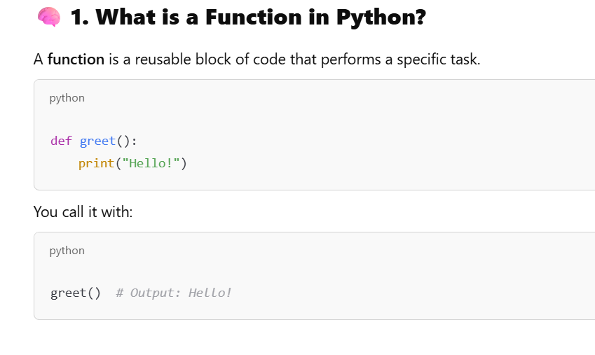
Functions

Slide 152
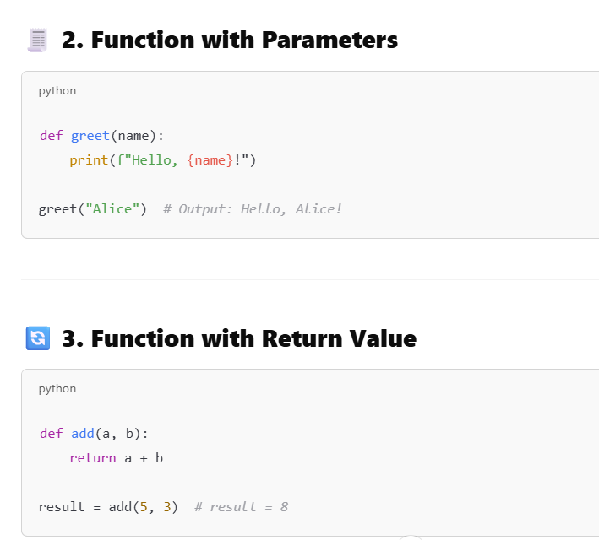
Functions

Slide 153
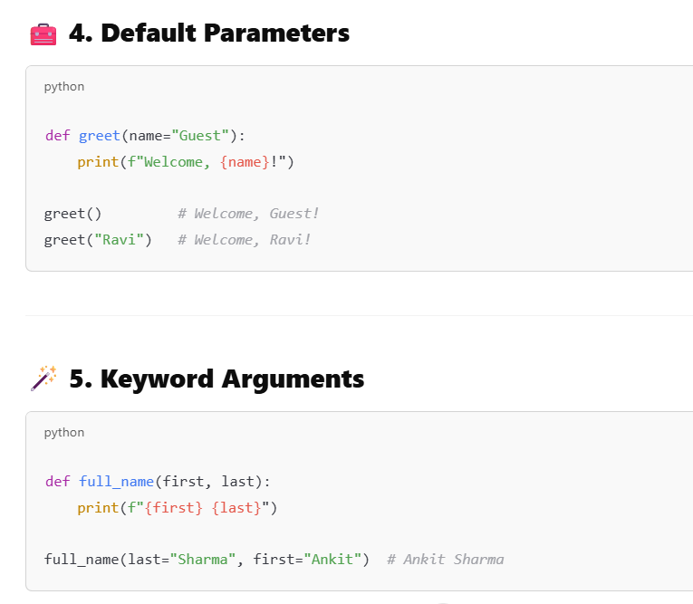
Functions

Slide 154
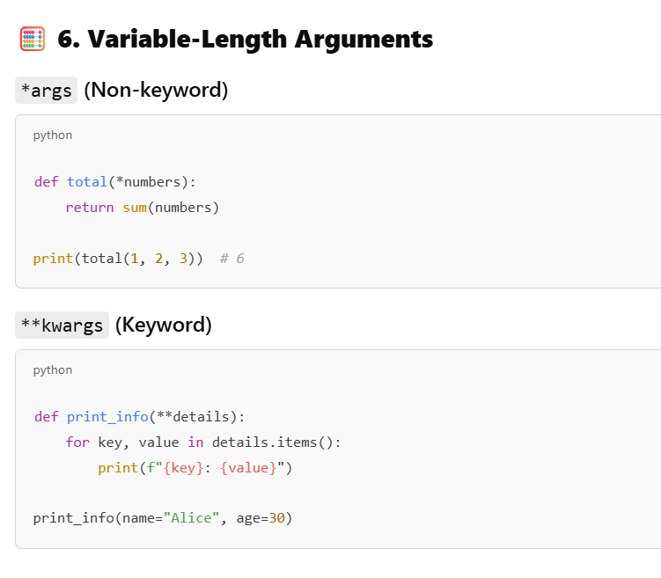
Functions

Slide 155
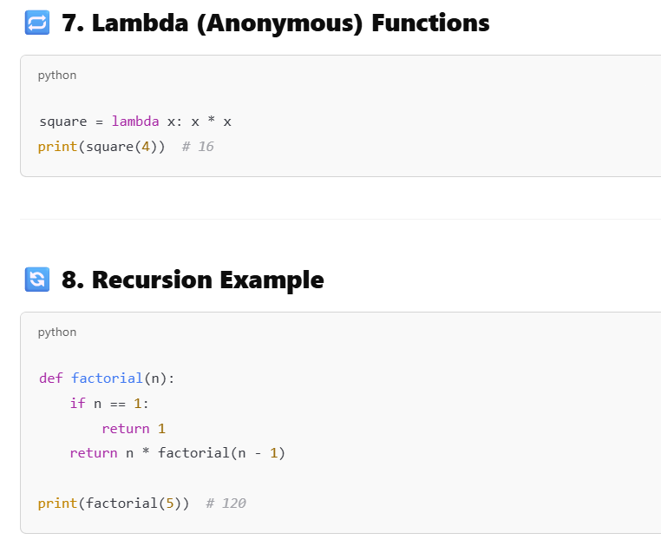
Functions

Slide 156
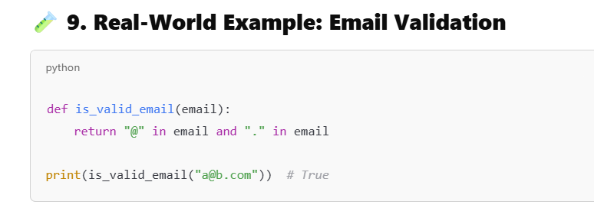
Functions

Slide 157
Module Basics
What is Modular Programming?
Modular programming is the practice of segmenting a single, complicated coding task into multiple, simpler, easier-to-manage sub-tasks.
We call these subtasks modules.
Therefore, we can build a bigger program by assembling different modules that act like building blocks.

Slide 158
Module Basics
A Python module is a file containing Python definitions and statements.
A module can define functions, classes, and variables.
A module can also include runnable code.
Grouping related code into a module makes the code easier to understand and use.
It also makes the code logically organized.

Slide 159
Types of Modules
There are three different ways to define a module in Python:
A module can be written in Python itself.
A module can be written in C and loaded dynamically at run-time, like the re (regular expression) module.
A built-in module is intrinsically contained in the interpreter, like the itertools module.

Slide 160
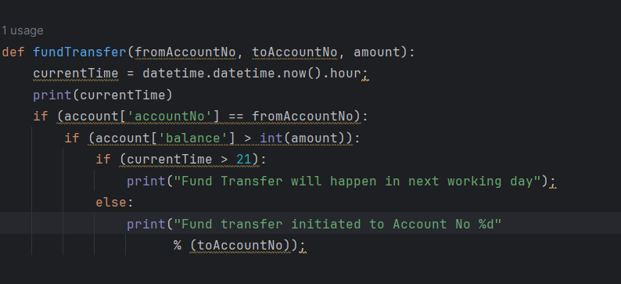
Module Basics

Slide 161
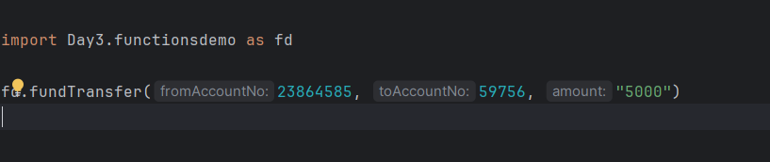
Module Basics

Slide 162
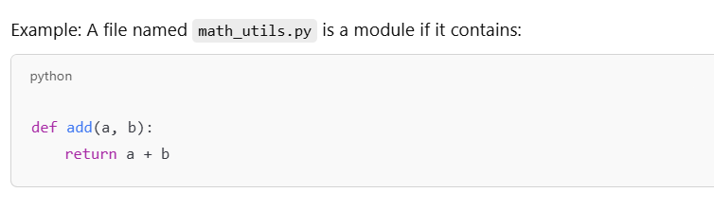
Module
A module is a file containing Python definitions and functions that you can reuse across projects.

Slide 163
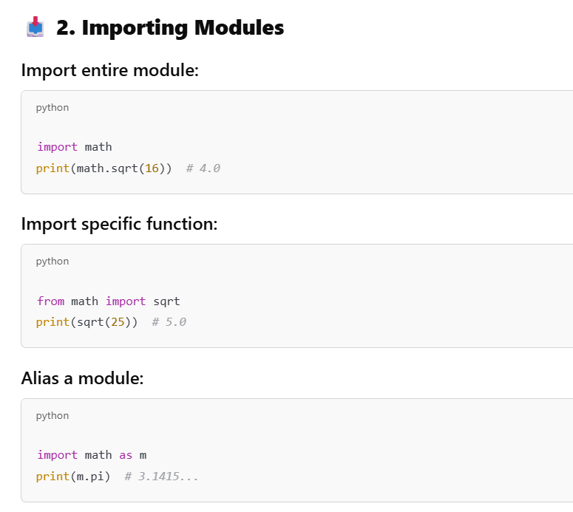
Module

Slide 164
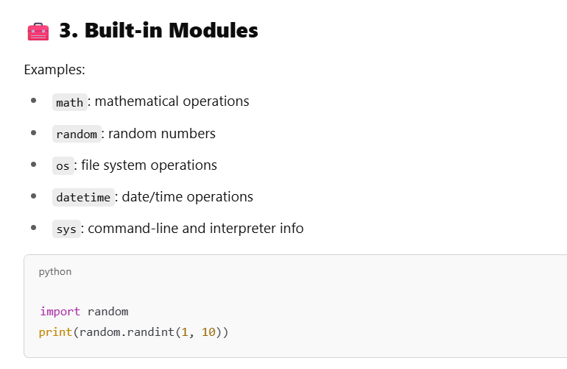
Module

Slide 165
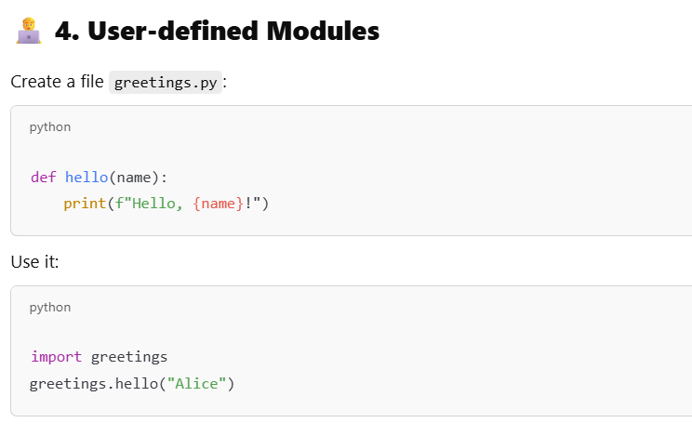
Module

Slide 166
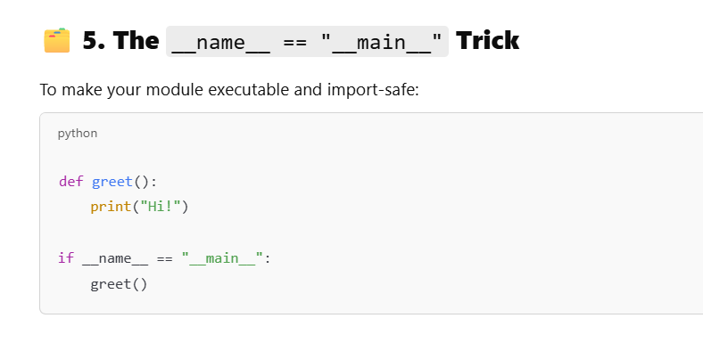
Module

Slide 167
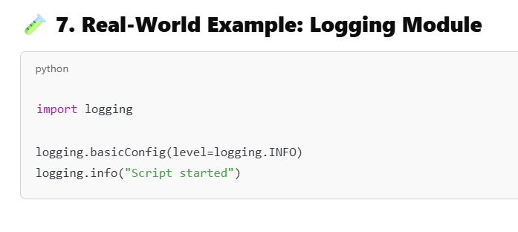
Module

Slide 168
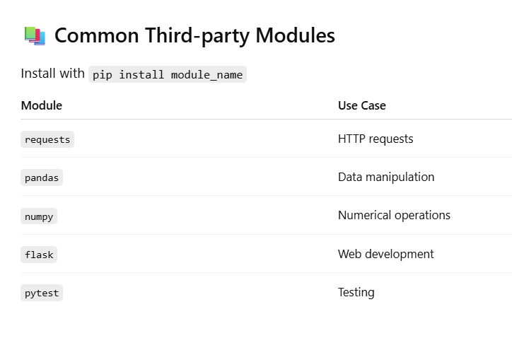
Module

Slide 169
Packages
Python Packages are a way to organize and structure python code into reusable components.
Like a folder that contains related Python files (modules) that work together to provide certain functionality.
Packages help keep your code organized, make it easier to manage and maintain, and allow you to share your code with others.
They’re like a toolbox where you can store and organize your tools (functions and classes) for easy access and reuse in different projects.

Slide 170
How to Create Package in Python?
Creating packages in Python allows you to organize your code into reusable and manageable modules.
Create a Directory: Start by creating a directory (folder) for your package.
This directory will serve as the root of your package structure.
Add Modules: Within the package directory, you can add Python files (modules) containing your code.
Each module should represent a distinct functionality or component of your package.
Init File: Include an __init__.py file in the package directory. This file can be empty or can contain an initialization code for your package.
It signals to Python that the directory should be treated as a package.

Slide 171
How to Create Package in Python?
Subpackages: You can create sub-packages within your package by adding additional directories containing modules, along with their own __init__.py files.
Importing: To use modules from your package, import them into your Python scripts using dot notation.
For example, if you have a module named module1.py inside a package named mypackage, you would import its function like this: from mypackage.module1 import greet.

Slide 172
How to Create Package in Python?
Distribution: If you want to distribute your package for others to use, you can create a setup.py file using Python’s setuptools library. This file defines metadata about your package and specifies how it should be installed.

Slide 173
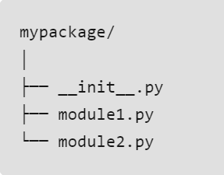
How to Create Package in Python?
Create a directory named mypackage.
Inside mypackage, create two Python files: module1.py and module2.py.
Create an __init__.py file inside mypackage (it can be empty).
Add some code to the modules.
Finally, demonstrate how to import and use the modules from the package.

Slide 174
__init__.py
The __init__.py file is a Python file that is executed when a package is imported.
__init__.py is a special file used in Python to define packages and initialize their namespaces.
It can contain an initialization code that runs when the package is imported.
Without this file, Python won’t recognize a directory as a package.
It serves two main purposes:
It marks the directory as a Python Package so that the interpreter can find the modules inside it.
It can contain initialization code for the Package, such as importing submodules, defining variables, or executing other code.

Slide 175
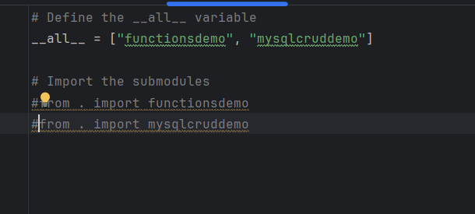
__init__.py
__all__ variable to specify which modules or names should be imported when using the wildcard (*) import.

Slide 176
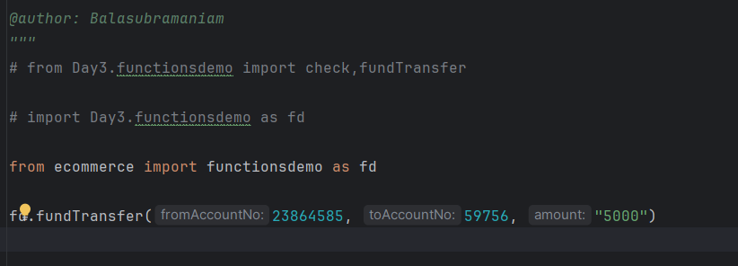
__init__.py

Slide 177
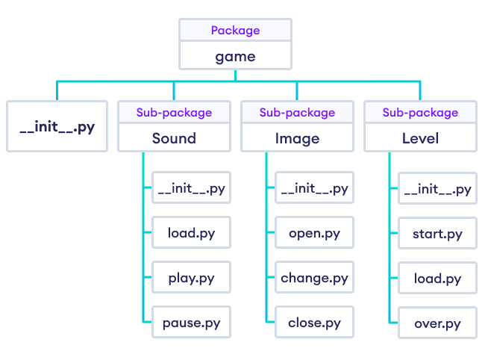
How to Create Package in Python?

Slide 178
Python Packages for Web frameworks
Flask
FastAPI
Django
Pyramid
Tornado
Falcon
Cherrypy
Bottle
Web2py

Slide 179
Python Packages for Statistical Analysis
NumPy
Pandas
SciPy
XGBoost
StatsModels
Yellowbrick
Arch
Dask-ML

Slide 180
Python Packages for Data Visualization
Matplotlib
Seaborn
Plotly
Bokeh
Altair
Pygal
Plotnine
Dash

Slide 181
Python Packages for Deep Learning
Scikit-learn
TensorFlow
torch
Keras
Keras-RL
Lasagne
Fastai

Slide 182
Python Packages for Natural Processing Language
NLTK
spaCy
FastText
Transformers
fastText
AllenNLP
TextBlob

Slide 183
Python Packages for Gen AI
Keras
spaCy
generative
GPy
Pillow
ImageIO
Fastai

Slide 184
Python Packages for Computer Vision
OpenCV
TensorFlow
torch
scikit-image
SimpleCV
ImageAI
imageio
Dlib
Theano
Mahotas

Slide 185
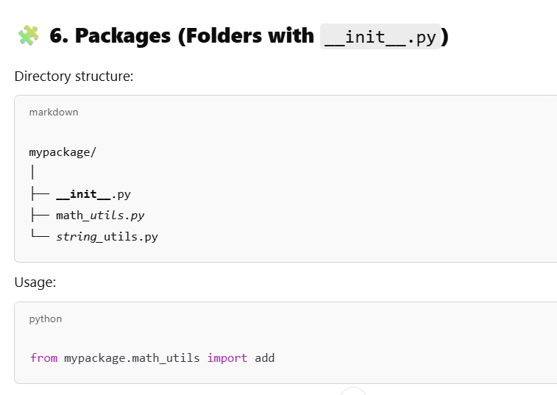
Package

Slide 186
Package
The __init__.py files are required to make Python treat the directories as containing packages;
this is done to prevent directories with a common name, such as string, from unintentionally hiding valid modules that occur later (deeper) on the module search path.
In the simplest case, __init__.py can just be an empty file, but it can also execute initialization code for the package.

Slide 187
Python Lists
Lists are the most versatile of Python's compound data types.
A list contains items separated by commas and enclosed within square brackets ([]).
To some extent, lists are similar to arrays in C.
One difference between them is that all the items belonging to a list can be of different data type.

Slide 188
Python Lists
The values stored in a list can be accessed using the slice operator ( [ ] and [ : ] ) with indexes starting at 0 in the beginning of the list and working their way to end-1.
The plus ( + ) sign is the list concatenation operator, and the asterisk ( * ) is the repetition operator.

Slide 189
Python Lists
#!/usr/bin/python
list = [ 'abcd', 786 , 2.23, 'john', 70.2 ]
tinylist = [123, 'john']
print list # Prints complete list
print list[0] # Prints first element of the list
print list[1:3] # Prints elements starting from 2nd till 3rd
print list[2:] # Prints elements starting from 3rd element
print tinylist * 2 # Prints list two times
print list + tinylist # Prints concatenated lists

Slide 190
Updating Lists:
#!/usr/bin/python
list = ['physics', 'chemistry', 1997, 2000];
print "Value available at index 2 : "
print list[2];
list[2] = 2001;
print "New value available at index 2 : "
print list[2];

Slide 191
Delete List Elements
#!/usr/bin/python
list1 = ['physics', 'chemistry', 1997, 2000];
print list1;
del list1[2];
print "After deleting value at index 2 : "
print list1;

Slide 192
Basic List Operations
Python Expression | Results | Description
len([1, 2, 3]) | 3 | Length
[1, 2, 3] + [4, 5, 6] | [1, 2, 3, 4, 5, 6] | Concatenation
['Hi!'] * 4 | ['Hi!', 'Hi!', 'Hi!', 'Hi!'] | Repetition
3 in [1, 2, 3] | True | Membership
for x in [1, 2, 3]: print x, | 1 2 3 | Iteration

Slide 193
Indexing, Slicing, and Matrixes:
L = ['spam', 'Spam', 'SPAM!']
L =L = ['spam', 'Spam', 'SPAM!‘]
Python Expression | Results | Description
L[2] | 'SPAM!' | Offsets start at zero
L[-2] | 'Spam' | Negative: count from the right
L[1:] | ['Spam', 'SPAM!'] | Slicing fetches sections

Slide 194
Built-in List Functions & Methods
SN | Function with Description
1 | cmp(list1, list2) Compares elements of both lists.
2 | len(list) Gives the total length of the list.
3 | max(list) Returns item from the list with max value.
4 | min(list) Returns item from the list with min value.
5 | list(seq) Converts a tuple into list.

Slide 195
Built-in List Functions & Methods
SN | Methods with Description
1 | list.append(obj) Appends object obj to list
2 | list.count(obj) Returns count of how many times obj occurs in list
3 | list.extend(seq) Appends the contents of seq to list
4 | list.index(obj) Returns the lowest index in list that obj appears
5 | list.insert(index, obj) Inserts object obj into list at offset index
6 | list.pop(obj=list[-1]) Removes and returns last object or obj from list
7 | list.remove(obj) Removes object obj from list
8 | list.reverse() Reverses objects of list in place
9 | list.sort([func]) Sorts objects of list, use compare func if given

Slide 196
Python Tuples
A tuple is another sequence data type that is similar to the list.
A tuple consists of a number of values separated by commas. Unlike lists, however, tuples are enclosed within parentheses.
The main differences between lists and tuples are: Lists are enclosed in brackets ( [ ] ), and their elements and size can be changed, while tuples are enclosed in parentheses ( ( ) ) and cannot be updated.

Slide 197
Python Tuples
#!/usr/bin/python
tuple = ( 'abcd', 786 , 2.23, 'john', 70.2 )
tinytuple = (123, 'john')
print tuple # Prints complete list
print tuple[0] # Prints first element of the list
print tuple[1:3] # Prints elements starting from 2nd till 3rd
print tuple[2:] # Prints elements starting from 3rd element
print tinytuple * 2 # Prints list two times
print tuple + tinytuple # Prints concatenated lists

Slide 198
Python Dictionary
Python's dictionaries are kind of hash table type.
They work like associative arrays or hashes found in Perl and consist of key-value pairs.
A dictionary keys can be almost any Python type, but are usually numbers or strings.
Values, on the other hand, can be any arbitrary Python object.
Dictionaries are enclosed by curly braces ( { } ) and values can be assigned and accessed using square braces ( [] ).
Dictionaries have no concept of order among elements. It is incorrect to say that the elements are "out of order"; they are simply unordered.

Slide 199
Python Dictionary
#!/usr/bin/python
dict = {}
dict['one'] = "This is one“
dict[2] = "This is two“
tinydict = {'name': 'john','code':6734, 'dept': 'sales'}
print dict['one'] # Prints value for 'one' key
print dict[2] # Prints value for 2 key
print tinydict # Prints complete dictionary
print tinydict.keys() # Prints all the keys
print tinydict.values() # Prints all the values

Slide 200
Built-in Dictionary functions
SN | Function with Description
1 | cmp(dict1, dict2) Compares elements of both dict.
2 | len(dict) Gives the total length of the dictionary. This would be equal to the number of items in the dictionary.
3 | str(dict) Produces a printable string representation of a dictionary
4 | type(variable) Returns the type of the passed variable. If passed variable is dictionary then it would return a dictionary type.

Slide 201
Built-in Dictionary functions
SN | Methods with Description
1 | dict.clear() Removes all elements of dictionary dict
2 | dict.copy() Returns a shallow copy of dictionary dict
2 | dict.fromkeys() Create a new dictionary with keys from seq and values set to value.
3 | dict.get(key, default=None) For key key, returns value or default if key not in dictionary
4 | dict.has_key(key) Returns true if key in dictionary dict, false otherwise

Slide 202
Built-in functions
5 | dict.items() Returns a list of dict's (key, value) tuple pairs
6 | dict.keys() Returns list of dictionary dict's keys
7 | dict.setdefault(key, default=None) Similar to get(), but will set dict[key]=default if key is not already in dict
8 | dict.update(dict2) Adds dictionary dict2's key-values pairs to dict
9 | dict.values() Returns list of dictionary dict2's values

Slide 203
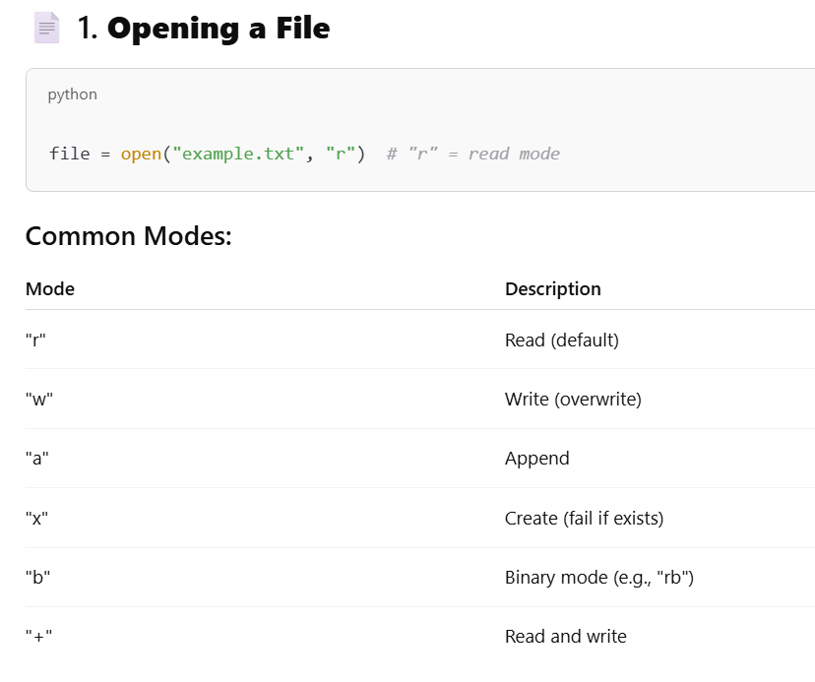
File I/O

Slide 204
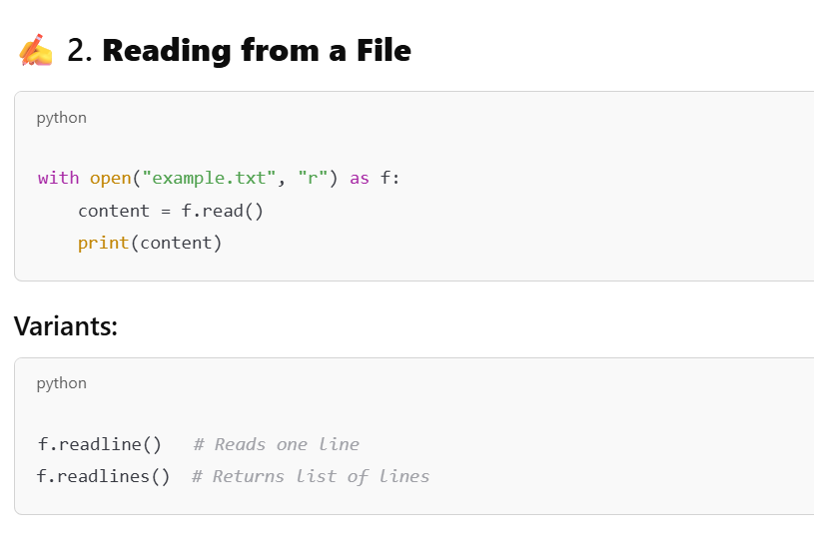
File I/O

Slide 205
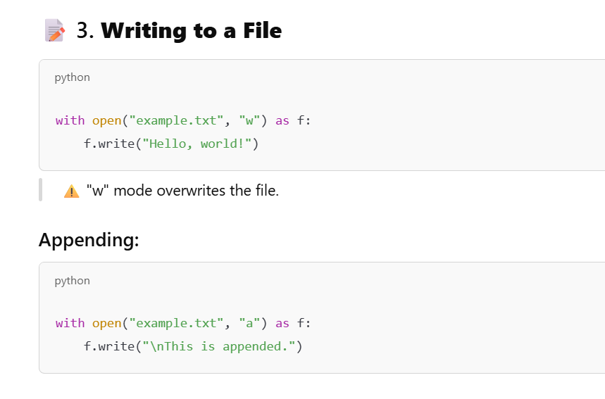
File I/O

Slide 206
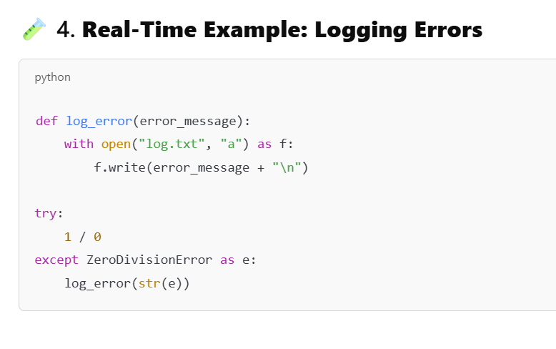
File I/O

Slide 207

File I/O

Slide 208

File I/O

Slide 209
What is Error Handling?
Error handling allows you to manage unexpected events or exceptions that occur during the execution of your program — without crashing it.

Slide 210

What is Error Handling?

Slide 211
Exceptions

Slide 212
Exceptions

Slide 213

What is Error Handling?

Slide 214

What is Error Handling?

Slide 215

What is Error Handling?

Slide 216

What is Error Handling?

Slide 217

What is Error Handling?

Slide 218

What is Error Handling?

Slide 219

Date abbreviation

Slide 220

Date abbreviation

Slide 221

Date abbreviation

Slide 222
What is a Virtual Environment?
A virtual environment is an isolated environment for Python projects that allows you to:
Install specific dependencies without affecting the global Python setup.
Work on multiple projects with different package versions.

Slide 223
2. Why Use Virtual Environments?
Avoid version conflicts between projects
Keep your global Python clean
Manage project-specific dependencies

Slide 224

2. Virtual Environments

Slide 225

3. Activating Environments

Slide 226

3. Deactivating the Environment

Slide 227

3. Packages in Environment

Slide 228

3. Packages in Environment

Slide 229

3. Packages in Environment

Slide 230

3. Packages in Environment

Slide 231

OOPS

Slide 232

OOPS

Slide 233

OOPS

Slide 234

OOPS

Slide 235

OOPS

Slide 236

OOPS

Slide 237

Python Capabilities

Slide 238

Python Libraries For Web Development

Slide 239

REST API

Slide 240
HTTP Concepts, REST API
🌐 1. What is HTTP?
HTTP = HyperText Transfer Protocol It’s the language your browser, backend, and apps use to talk to each other.
You send a request → you get a response.

Slide 241
📨 2. HTTP Request Structure
When the client wants something, it sends a request that looks like:
✔ Request Line
GET /products HTTP/1.1
✔ Headers
Content-Type: application/json
Authorization: Bearer <token>
User-Agent: Chrome
✔ Body (optional)
Used in POST/PUT:
{
"name": "Laptop",
"price": 50000
}

Slide 242
📦 3. HTTP Response Structure
Server replies with:
✔ Status Line
HTTP/1.1 200 OK
✔ Headers
Content-Type: application/json
✔ Body
{
"message": "Product created successfully"
}

Slide 243
🚦 4. HTTP Methods (Very Important)
Method | Purpose | Example
GET | Fetch data | Get all users
POST | Create new data | Add user
PUT | Update entire record | Replace user
PATCH | Update partial | Change user email
DELETE | Remove resource | Delete user

Slide 244
🔢 5. HTTP Status Codes
2xx → Success
200 OK
201 Created
204 No Content
4xx → Client Errors
400 Bad Request
401 Unauthorized
403 Forbidden
404 Not Found

Slide 245
🔢 5. HTTP Status Codes
5xx → Server Errors
500 Internal Server Error
503 Service Unavailable

Slide 246
🧱 6. What is REST?
REST = Representational State Transfer It’s an architecture style for designing APIs.
REST APIs follow rules for:
✔ Resources ✔ URLs ✔ HTTP methods ✔ Stateless communication ✔ JSON responses ✔ Layered system

Slide 247
🔑 7. REST Important Principles (Simple Explanation)
1️⃣ Stateless
Server doesn't remember anything between requests. Every request contains all information needed.
2️⃣ Resource-Based URLs
URLs represent nouns, not verbs.
❌ BAD
/getAllUsers
/addNewUser

Slide 248
🔑 7. REST Important Principles (Simple Explanation)
✔ GOOD
/users
/users/1

Slide 249
🔑 7. REST Important Principles (Simple Explanation)
3️⃣ Use HTTP Methods Properly
GET /users
POST /users
PUT /users/10
PATCH /users/10
DELETE /users/10
4️⃣ Return Proper Status Codes
REST APIs must clearly tell if action succeeded or failed.

Slide 250
🔑 7. REST Important Principles (Simple Explanation)
5️⃣ Use JSON
REST APIs usually use JSON format.

Slide 251
🚀 Path Parameters,Query and Body Parameters
Param Type | Comes From | Example URL | FastAPI Usage
Path | Part of the route | /users/5 | @app.get("/users/{id}")
Query | After ? | /users?active=true | def fn(active: bool)
Body | Request body (JSON) | POST/PUT | def fn(obj: Model)

Slide 252
🌟 What is Pydantic?
Pydantic = Data validation + Data parsing using Python type hints
FastAPI automatically uses Pydantic to:
Validate request bodies
Convert data types
Generate error messages
Auto-generate Swagger documentation
Create clean, structured JSON
It’s basically magic ✨

Slide 253
Fast API vs Django
Feature / Aspect | FastAPI | Django
Type | API framework (lightweight) | Full-stack web framework
Best For | REST APIs, microservices, async workloads | Websites, dashboards, admin apps, monoliths
Performance | ⭐ Extremely fast (async native) | Good, but not FastAPI-level
Architecture | ASGI (modern, async) | WSGI (sync) + optional ASGI
Learning Curve | Easy if you know Python typing | Medium; has “Django way”
Built-in Features | Minimal (add your own ORM, admin, auth) | ⭐ ORM, Auth, Admin, Forms, Templates, Sessions
Automatic Docs | ⭐ Yes (Swagger / ReDoc auto) | No (unless using Django REST Framework)
ORM | No built-in (use SQLAlchemy / SQLModel) | ⭐ Built-in ORM

Slide 254
Fast API vs Django
Feature / Aspect | FastAPI | Django
Admin Panel | No | ⭐ Auto-generated Admin Panel
Template System | No | Yes (Jinja-like templates)
Ecosystem | Growing but smaller | Huge (Django + DRF + plugins)
Use Case Fit | Mobile backends, async IO apps, ML model serving | Portals, CMS, ERP-like apps, dashboards
Code Style | Modern, type-hinted, concise | Traditional MVC/MTV
Async Support | Built-in native async | Partial (some async, ecosystem still catching up)
Community | Smaller but active | Very large, mature

Slide 255
What is FastAPI?
FastAPI is a modern Python web framework for building REST APIs (and async apps) with:
Super high performance (on par with Node & Go thanks to Uvicorn/Starlette)
Auto-generated Swagger UI ✨
Pydantic models for validation
Async support
Dependency Injection system
Zero boilerplate

Slide 256

1. Project Structure (Recommended)

Slide 257
🛠️ 2. Installing FastAPI & Uvicorn
👉 Step 1: Create a virtual environment
Windows:
python -m venv env
env\Scripts\activate
👉 Step 2: Install FastAPI
pip install fastapi
👉 Step 3: Install Uvicorn server
pip install uvicorn[standard]

Slide 258
🛠️ 2. Installing FastAPI & Uvicorn
👉 Step 4: Create requirements.txt (optional but good practice)
pip freeze > requirements.txt

Slide 259
Why this structure?
main.py → Entry point
routers/ → API endpoints
schemas/ → Pydantic models (request/response validation)
models/ → DB models (SQLAlchemy etc.)
db/ → Database connection
config.py → App settings (env vars, secrets)
Clean. Reusable. Easy to scale.

Slide 260
Run Project
Step 1
Run
Aws configure
Then
uvicorn main:app –reload
#open in browser using
http://127.0.0.1:8000/docs

Slide 261


Fast API JWT

Slide 262



Fast API JWT

Slide 263

Logger Middleware

Slide 264

Audit Middleware With Background Tasks

Slide 265


Audit Middleware With Background Tasks

Slide 266

Flask App

Slide 267

Flask App

Slide 268

Flask App

Slide 269

Flask App

Slide 270

Flask App

Slide 271

Flask App

Slide 272

Django

Slide 273

Django Features

Slide 274

Django Architecture

Slide 275

Django Installation

Slide 276

Django MVC Post,Put and Delete

Slide 277
Django MVC Post,Put and Delete
Cross-Site Request Forgery (CSRF) is a type of attack that tricks a user into executing an unwanted action in a web application where they are authenticated.
For example, a user might be logged into their bank account, and a malicious site could trick them into transferring money without their consent.

Slide 278
Django MVC Post,Put and Delete
A user logs into a secure website (e.g., their banking app) with valid credentials.
The user then visits a malicious website in another tab or window.
That website contains hidden forms or malicious scripts that trick the user’s browser into sending a request to the banking website, performing actions like transferring funds or changing account details.

Slide 279
Django MVC Post,Put and Delete
Django’s CSRF protection works by:
Generating a token: A CSRF token is generated for each user session.
Embedding the token in forms: Every form in Django is automatically protected by embedding the CSRF token in hidden fields.
Verifying the token: When the form is submitted, Django checks if the submitted token matches the one stored in the user session.

Slide 280

Implementing Django CSRF Protection

Slide 281

Implementing Django CSRF Protection

Slide 282
Implementing Django CSRF Protection
When the form is submitted, Django verifies that the CSRF token included in the form matches the one stored in the session, ensuring the request is legitimate

Slide 283
Best Practices for Securing Your Django App
Keep CSRF Protection Enabled: Never disable CSRF protection unless absolutely necessary.
Use HTTPS: Always serve your application over HTTPS to prevent man-in-the-middle attacks that could compromise your CSRF tokens.
Audit Your Views: Ensure that all forms and sensitive operations are protected by CSRF tokens. Always use {% csrf_token %} in templates or the X-CSRFToken header in AJAX requests.
Be Cautious with @csrf_exempt: If you must use @csrf_exempt, do so with caution and only for specific views where CSRF protection isn’t necessary.
Regularly Update Django: Security patches and improvements are frequently released, so always keep your Django version up-to-date.

Slide 284

What Python Version You can use for Django

Slide 285
Regular Expression
re.match(pattern, string, flags=0)
Parameter | Description
pattern | This is the regular expression to be matched.
string | This is the string which would be searched to match the pattern
flags | You can specifiy different flags using bitwise OR (|). These are modifiers which are listed in the table below.

Slide 286
Regular Expression
Match Object Methods | Description
group(num=0) | This methods returns entire match (or specific subgroup num)
groups() | This method return all matching subgroups in a tuple (empty if there weren't any)

Slide 287
Regular-expression Modifiers - Option Flags
Modifier | Description
re.I | Performs case-insensitive matching.
re.L | Interprets words according to the current locale.This interpretation affects the alphabetic group (\w and \W), as well as word boundary behavior (\b and \B).
re.M | Makes $ match the end of a line (not just the end of the string) and makes ^ match the start of any line (not just the start of the string).
re.S | Makes a period (dot) match any character, including a newline.
re.U | Interprets letters according to the Unicode character set. This flag affects the behavior of \w, \W, \b, \B.
re.X | Permits "cuter" regular expression syntax. It ignores whitespace (except inside a set [] or when escaped by a backslash), and treats unescaped # as a comment marker.

Slide 288
Regular-expression Modifiers - Option Flags
Modifier | Description
re.I | Performs case-insensitive matching.
re.L | Interprets words according to the current locale.This interpretation affects the alphabetic group (\w and \W), as well as word boundary behavior (\b and \B).
re.M | Makes $ match the end of a line (not just the end of the string) and makes ^ match the start of any line (not just the start of the string).
re.S | Makes a period (dot) match any character, including a newline.
re.U | Interprets letters according to the Unicode character set. This flag affects the behavior of \w, \W, \b, \B.
re.X | Permits "cuter" regular expression syntax. It ignores whitespace (except inside a set [] or when escaped by a backslash), and treats unescaped # as a comment marker.

Slide 289
Python Debugging
Python –m pdb filename

Slide 290
Python Debugging
Command | Short form | What it does
args | a | Print the argument list of the current function
break | b | Creates a breakpoint (requires parameters) in the program execution
continue | c or cont | Continues program execution
help | h | Provides list of commands or help for a specified command
jump | j | Set the next line to be executed
list | l | Print the source code around the current line
next | n | Continue execution until the next line in the current function is reached or returns
step | s | Execute the current line, stopping at first possible occasion
pp | pp | Pretty-prints the value of the expression
quit or exit | q | Aborts the program
return | r | Continue execution until the current function returns

Slide 291
PyIInstaller
pyinstaller.exe --onefile --windowed --icon=app.ico app.py

Slide 292
Creating the Application Structure
/MyApplication
|-- run.py
|-- config.py
|__ /app
|-- __init__.py
|-- /module_one
|-- __init__.py
|-- controllers.py
|-- models.py
|__ /templates
|-- module_one
|-- hello.html
|__ /static
|__ ..
|__ .

Slide 293
How to Create The Distribution File
python setup.py sdist

Slide 294
How to Install The Application
python setup.py install
For development
python setup.py develop

Slide 295
SNMP
https://pynet.twb-tech.com/blog/snmp/python-snmp-intro.html

Slide 296
SNMP
snmpget -v 2c -c <community> <ip_addr> .1.3.6.1.2.1.1.1.0

Slide 297
Django Framework
pip install Django
python -c "import django; print(django.get_version())“
python -m django --version
django-admin startproject myproject
cd myproject
python manage.py runserver
python manage.py startapp myapp

Slide 298
Django Framework
INSTALLED_APPS = (
'django.contrib.admin',
'django.contrib.auth',
'django.contrib.contenttypes',
'django.contrib.sessions',
'django.contrib.messages',
'django.contrib.staticfiles',
'myapp',
)

Slide 299
Django Framework
python manage.py migrate
python manage.py makemigrations polls
python manage.py sqlmigrate polls 0001
python manage.py migrate
python manage.py createsuperuser
python manage.py runserver
http://localhost:8000/admin/
http://localhost:8000/hello/12/

Slide 300
Python Web Server
Python –m http.server 8080

Slide 301
Higher Order Functions

Slide 302
MAP,FILTER AND REDUCE

Slide 303
Meta class
A metaclass is a class whose instances are classes. Like an "ordinary" class defines the behavior of the instances of the class, a metaclass defines the behavior of classes and their instances.
Metaclasses are not supported by every object oriented programming language. Those programming language, which support metaclasses, considerably vary in way the implement them. Python is supporting them

Slide 304
Meta Class
There are numerous use cases for metaclasses. Just to name a few:
logging and profiling
interface checking
registering classes at creation time
automatically adding new methods
automatic property creation
proxies
automatic resource locking/synchronization.

Slide 305

Meta Class

Slide 306
Dynamic Meta class
>>> type(3)
<class 'int'>
>>> type(['foo', 'bar', 'baz'])
<class 'list'>
>>> t = (1, 2, 3, 4, 5)
>>> type(t)
<class 'tuple'>

Slide 307
Dynamic Meta class
>>> class Foo:
... pass
...
>>> type(Foo())
<class '__main__.Foo'>

Slide 308
Dynamic Meta class
You can also call type() with three arguments—type(<name>, <bases>, <dct>):
<name> specifies the class name. This becomes the __name__ attribute of the class.
<bases> specifies a tuple of the base classes from which the class inherits. This becomes the __bases__ attribute of the class.
<dct> specifies a namespace dictionary containing definitions for the class body. This becomes the __dict__ attribute of the class.

Slide 309
Dynamic Meta class
>>> Bar = type('Bar', (Foo,), dict(attr=100))
>>> x = Bar()
>>> x.attr
100
>>> x.__class__
<class '__main__.Bar'>
>>> x.__class__.__bases__
(<class '__main__.Foo'>,)

Slide 310
Decorators
A decorator in Python is any callable Python object that is used to modify a function or a class.
A reference to a function "func" or a class "C" is passed to a decorator and the decorator returns a modified function or class.
The modified functions or classes usually contain calls to the original function "func" or class "C".

Slide 311
Pandas
Pandas is used for data manipulation, analysis and cleaning. Python pandas is well suited for different kinds of data, such as:
Tabular data with heterogeneously-typed columns
Ordered and unordered time series data
Arbitrary matrix data with row & column labels
Unlabelled data
Any other form of observational or statistical data sets

Slide 312

Pandas

Slide 313
Lambdas
In Python, anonymous function is a function that is defined without a name.
While normal functions are defined using the def keyword, in Python anonymous functions are defined using the lambda keyword.

Slide 314
How to use lambda Functions in Python?
A lambda function in python has the following syntax.
Syntax of Lambda Function in python
lambda arguments: expression
Lambda functions can have any number of arguments but only one expression.
The expression is evaluated and returned. Lambda functions can be used wherever function objects are required.

Slide 315
How to use lambda Functions in Python?
Lambda functions can have any number of arguments but only one expression.
The expression is evaluated and returned.
Lambda functions can be used wherever function objects are required.

Slide 316
Regular Expression
A regular expression is a special sequence of characters that helps you match or find other strings or sets of strings, using a specialized syntax held in a pattern.
Regular expressions are widely used in UNIX world.
The module re provides full support for Perl-like regular expressions in Python.
The re module raises the exception re.error if an error occurs while compiling or using a regular expression

Slide 317
Regular Expression
In regular expressions, there are twelve metacharacters that should be escaped if they are to be used with their literal meaning:
Backslash \
• Caret ^
• Dollar sign $
• Dot .

Slide 318
Regular Expression
Pipe symbol |
• Question mark ?
• Asterisk *
• Plus sign +
• Opening parenthesis (
• Closing parenthesis )
• Opening square bracket [
• The opening curly brace {

Slide 319
Regular Expression

Slide 320
Predefined character classes

Slide 321
Predefined character classes

Slide 322
Quantifiers

Slide 323
Boundary Matchers

Slide 324
Boundary Matchers

Slide 325
Boundary Matchers

Slide 326
Boundary Matchers

Slide 327
Boundary Matchers

Slide 328
Functions

Slide 329
Regular Expressions
[] | A set of characters | "[a-m]"
\ | Signals a special sequence (can also be used to escape special characters) | "\d"
. | Any character (except newline character) | "he..o"
^ | Starts with | "^hello"
$ | Ends with | "world$"
* | Zero or more occurrences | "aix*"
+ | One or more occurrences | "aix+"
{} | Excactly the specified number of occurrences | "al{2}"
| | Either or | "falls|stays"
() | Capture and group

Slide 330
Regular Expressions
Character | Description | Example
\A | Returns a match if the specified characters are at the beginning of the string | "\AThe"
\b | Returns a match where the specified characters are at the beginning or at the end of a word | r"\bain" r"ain\b"
\B | Returns a match where the specified characters are present, but NOT at the beginning (or at the end) of a word | r"\Bain" r"ain\B"
\d | Returns a match where the string contains digits (numbers from 0-9) | "\d"
\D | Returns a match where the string DOES NOT contain digits | "\D"
\s | Returns a match where the string contains a white space character | "\s"
\S | Returns a match where the string DOES NOT contain a white space character | "\S"
\w | Returns a match where the string contains any word characters (characters from a to Z, digits from 0-9, and the underscore _ character) | "\w"
\W | Returns a match where the string DOES NOT contain any word characters | "\W"
\Z | Returns a match if the specified characters are at the end of the string | "Spain\Z"

Slide 331
Regular Expressions
Set | Description
[arn] | Returns a match where one of the specified characters (a, r, or n) are present
[a-n] | Returns a match for any lower case character, alphabetically between a and n
[^arn] | Returns a match for any character EXCEPT a, r, and n
[0123] | Returns a match where any of the specified digits (0, 1, 2, or 3) are present
[0-9] | Returns a match for any digit between 0 and 9
[0-5][0-9] | Returns a match for any two-digit numbers from 00 and 59
[a-zA-Z] | Returns a match for any character alphabetically between a and z, lower case OR upper case
[+] | In sets, +, *, ., |, (), $,{} has no special meaning, so [+] means: return a match for any +character in the string

Slide 332
Sub Process
The subprocess module allows you to spawn new processes, connect to their input/output/error pipes, and obtain their return codes.
This module intends to replace several older modules and functions:
os.system
os.spawn*

Slide 333
Using Sub Process Module
The recommended approach to invoking subprocesses is to use the run() function for all use cases it can handle. For more advanced use cases, the underlying Popen interface can be used directly.
The run() function was added in Python 3.5; if you need to retain compatibility

Slide 334
Using Sub Process Module
subprocess.run(args, *, stdin=None, input=None, stdout=None, stderr=None, capture_output=False, shell=False, cwd=None, timeout=None, check=False, encoding=None, errors=None, text=None, env=None, universal_newlines=None)

Slide 335
Regular Expressions
A regular expression is a special sequence of characters that helps you match or find other strings or sets of strings, using a specialized syntax held in a pattern.
Regular expressions are widely used in UNIX world.
The module re provides full support for Perl-like regular expressions in Python.
The re module raises the exception re.error if an error occurs while compiling or using a regular expression

Slide 336
Regular Expressions
A regular expression is a pattern of text that consists of ordinary characters (for example, letters a through z or numbers 0 through 9) and special characters known as meta characters.
This pattern describes the strings that would match when applied to a text.

Slide 337
Regular Expressions - Literals
Literals are the simplest form of pattern matching in regular expressions.
They will simply succeed whenever that literal is found.
If we apply the regular expression /fox/ to search the phrase The quick brown fox jumps over the lazy dog, we will find one match:

Slide 338
Regular Expressions - Literals
However, we can also obtain several results instead of just one, if we apply the
regular expression /be/ to the following phrase To be, or not to be:

Slide 339
Regular Expressions - Literals
Using the backslash method, we can convert the previous expression to /\(this is inside\)/ and apply it again to the same text to have the parentheses included in the result:

Slide 340
Regular Expression
In regular expressions, there are twelve meta characters that should be escaped if they are to be used with their literal meaning:
Backslash \
• Caret ^
• Dollar sign $
• Dot .

Slide 341
Regular Expression
Pipe symbol |
• Question mark ?
• Asterisk *
• Plus sign +
• Opening parenthesis (
• Closing parenthesis )
• Opening square bracket [
• The opening curly brace {

Slide 342
Regular Expressions Character classes
The character classes (also known as character sets) allow us to define a character that will match if any of the defined characters on the set is present.
To define a character class, we should use the opening square bracket meta character [, then any accepted characters, and finally close with a closing square bracket ].
For instance, let's define a regular expression that can match the word "license" in British and American English written form:

Slide 343
Regular Expressions Character classes
It is possible to also use the range of a character.
This is done by leveraging the hyphen symbol (-) between two related characters; for example, to match any lowercase letter we can use [a-z].
Likewise, to match any single digit we can define the character set [0-9].

Slide 344
Regular Expression
The character classes' ranges can be combined to be able to match a character against many ranges by just putting one range after the other—no special separation is required.
For instance, if we want to match any lowercase or uppercase alphanumeric character, we can use [0-9a-zA-Z] (see next table for a more detailed explanation).
This can be alternatively written using the union mechanism: [0-9[a-z[A-Z]]].

Slide 345
Predefined character classes

Slide 346
Predefined character classes

Slide 347
Quantifiers

Slide 348
Boundary Matchers

Slide 349
Boundary Matchers

Slide 350
Boundary Matchers

Slide 351
Boundary Matchers

Slide 352
Boundary Matchers

Slide 353
Functions

Slide 354
Regular Expressions
[] | A set of characters | "[a-m]"
\ | Signals a special sequence (can also be used to escape special characters) | "\d"
. | Any character (except newline character) | "he..o"
^ | Starts with | "^hello"
$ | Ends with | "world$"
* | Zero or more occurrences | "aix*"
+ | One or more occurrences | "aix+"
{} | Excactly the specified number of occurrences | "al{2}"
| | Either or | "falls|stays"
() | Capture and group

Slide 355
Regular Expressions
Character | Description | Example
\A | Returns a match if the specified characters are at the beginning of the string | "\AThe"
\b | Returns a match where the specified characters are at the beginning or at the end of a word | r"\bain" r"ain\b"
\B | Returns a match where the specified characters are present, but NOT at the beginning (or at the end) of a word | r"\Bain" r"ain\B"
\d | Returns a match where the string contains digits (numbers from 0-9) | "\d"
\D | Returns a match where the string DOES NOT contain digits | "\D"
\s | Returns a match where the string contains a white space character | "\s"
\S | Returns a match where the string DOES NOT contain a white space character | "\S"
\w | Returns a match where the string contains any word characters (characters from a to Z, digits from 0-9, and the underscore _ character) | "\w"
\W | Returns a match where the string DOES NOT contain any word characters | "\W"
\Z | Returns a match if the specified characters are at the end of the string | "Spain\Z"

Slide 356
Regular Expressions
Set | Description
[arn] | Returns a match where one of the specified characters (a, r, or n) are present
[a-n] | Returns a match for any lower case character, alphabetically between a and n
[^arn] | Returns a match for any character EXCEPT a, r, and n
[0123] | Returns a match where any of the specified digits (0, 1, 2, or 3) are present
[0-9] | Returns a match for any digit between 0 and 9
[0-5][0-9] | Returns a match for any two-digit numbers from 00 and 59
[a-zA-Z] | Returns a match for any character alphabetically between a and z, lower case OR upper case
[+] | In sets, +, *, ., |, (), $,{} has no special meaning, so [+] means: return a match for any +character in the string

Slide 357
Regular Expression
Expression | String | Matched?
^a...s$ | abs | No match
 | alias | Match
 | abyss | Match
 | Alias | No match
 | An abacus | No match

Slide 358
Regular Expression Meta Characters
[] - Square brackets
Square brackets specifies a set of characters you wish to match.
Expression | String | Matched?
[abc] | a | 1 match
 | ac | 2 matches
 | Hey Jude | No match
 | abc de ca | 5 matches

Slide 359
Regular Expression Meta Characters
. - Period
A period matches any single character (except newline '\n').
Expression | String | Matched?
.. | a | No match
 | ac | 1 match
 | acd | 1 match
 | acde | 2 matches (contains 4 characters)

Slide 360
Regular Expression Meta Characters
^ - Caret
The caret symbol ^ is used to check if a string starts with a certain character.
Expression | String | Matched?
^a | a | 1 match
 | abc | 1 match
 | bac | No match
^ab | abc | 1 match
 | acb | No match (starts with a but not followed by b)

Slide 361
Regular Expression Meta Characters
$ - Dollar
The dollar symbol $ is used to check if a string ends with a certain character..
Expression | String | Matched?
a$ | a | 1 match
 | formula | 1 match
 | cab | No match

Slide 362
Regular Expression Meta Characters
* - Star
The star symbol * matches zero or more occurrences of the pattern left to it..
Expression | String | Matched?
ma*n | mn | 1 match
 | man | 1 match
 | maaan | 1 match
 | main | No match (a is not followed by n)
 | woman | 1 match

Slide 363
Regular Expression Meta Characters
+ - Plus
The plus symbol + matches one or more occurrences of the pattern left to it.
Expression | String | Matched?
ma+n | mn | No match (no a character)
 | man | 1 match
 | maaan | 1 match
 | main | No match (a is not followed by n)
 | woman | 1 match

Slide 364
Regular Expression Meta Characters
? - Question Mark
The question mark symbol ? matches zero or one occurrence of the pattern left to it.
Expression | String | Matched?
ma?n | mn | 1 match
 | man | 1 match
 | maaan | No match (more than one a character)
 | main | No match (a is not followed by n)
 | woman | 1 match

Slide 365
Regular Expression Meta Characters
{} - Braces
Consider this code: {n,m}. This means at least n, and at most m repetitions of the pattern left to it.
Expression | String | Matched?
a{2,3} | abc dat | No match
 | abc daat | 1 match (at daat)
 | aabc daaat | 2 matches (at aabc and daaat)
 | aabc daaaat | 2 matches (at aabc and daaaat)

Slide 366
Regular Expression Meta Characters
Special Sequences
Special sequences make commonly used patterns easier to write. Here's a list of special sequences:
\A - Matches if the specified characters are at the start of a string.
Expression | String | Matched?
\Athe | the sun | Match
 | In the sun | No match

Slide 367
Regular Expression Meta Characters
\b - Matches if the specified characters are at the beginning or end of a word.
Expression | String | Matched?
\bfoo | football | Match
 | a football | Match
 | afootball | No match
foo\b | the foo | Match
 | the afoo test | Match
 | the afootest | No match

Slide 368
Regular Expression Meta Characters
\B - Opposite of \b. Matches if the specified characters are not at the beginning or end of a word.
Expression | String | Matched?
\Bfoo | football | No match
 | a football | No match
 | afootball | Match
foo\B | the foo | No match
 | the afoo test | No match
 | the afootest | Match

Slide 369
Regular Expression Meta Characters
\d - Matches any decimal digit. Equivalent to [0-9]
Expression | String | Matched?
\d | 12abc3 | 3 matches (at 12abc3)
 | Python | No match

Slide 370
Regular Expression Meta Characters
\D - Matches any non-decimal digit. Equivalent to [^0-9]
Expression | String | Matched?
\D | 1ab34"50 | 3 matches (at 1ab34"50)
 | 1345 | No match

Slide 371
Regular Expression Meta Characters
\s - Matches where a string contains any whitespace character. Equivalent to [ \t\n\r\f\v].
Expression | String | Matched?
\s | Python RegEx | 1 match
 | PythonRegEx | No match

Slide 372
Regular Expression Meta Characters
\w - Matches any alphanumeric character (digits and alphabets). Equivalent to [a-zA-Z0-9_]. By the way, underscore _ is also considered an alphanumeric character.
Expression | String | Matched?
\w | 12&": ;c | 3 matches (at 12&": ;c)
 | %"> ! | No match

Slide 373
Regular Expression Meta Characters
\Z - Matches if the specified characters are at the end of a string.
Expression | String | Matched?
\ZPython | I like Python | 1 match
 | I like Python | No match
 | Python is fun. | No match

Slide 374
Regular Expression
re.findall()
The re.findall() method returns a list of strings containing all matches.
string = 'hello 12 hi 89. Howdy 34'
pattern = '\d+'
result = re.findall(pattern, string)
print(result)
# Output: ['12', '89', '34']

Slide 375
Regular Expression
re.split()
The re.split method splits the string where there is a match and returns a list of strings where the splits have occurred.
string = 'Twelve:12 Eighty nine:89.'
pattern = '\d+'
result = re.split(pattern, string)
print(result)
# Output: ['Twelve:', ' Eighty nine:', '.']

Slide 376
Regular Expression
re.split()
The re.split method splits the string where there is a match and returns a list of strings where the splits have occurred.
string = 'Twelve:12 Eighty nine:89.'
pattern = '\d+'
result = re.split(pattern, string)
print(result)
# Output: ['Twelve:', ' Eighty nine:', '.']

Slide 377
Regular Expression
re.split()
The re.split method splits the string where there is a match and returns a list of strings where the splits have occurred.
string = 'Twelve:12 Eighty nine:89 Nine:9.'
pattern = '\d+'
# maxsplit = 1
# split only at the first occurrence
result = re.split(pattern, string, 1)
print(result)
# Output: ['Twelve:', ' Eighty nine:89 Nine:9.']

Slide 378
Regular Expression
re.sub()
The syntax of re.sub() is:
re.sub(pattern, replace, string)
The method returns a string where matched occurrences are replaced with the content of replace variable.
multiline string
string = 'abc 12\
de 23 \n f45 6'
# matches all whitespace characters
pattern = '\s+'
# empty string
replace = ''
new_string = re.sub(pattern, replace, string)
print(new_string)
# Output: abc12de23f456

Slide 379
Regular Expression
re.sub()
The syntax of re.sub() is:
re.sub(pattern, replace, string)
The method returns a string where matched occurrences are replaced with the content of replace variable.
# multiline string
string = 'abc 12\
de 23 \n f45 6'
# matches all whitespace characters
pattern = '\s+'
replace = ''
new_string = re.sub(r'\s+', replace, string, 1)
print(new_string)
# Output:
# abc12de 23
# f45 6

Slide 380
Regular Expression
re.subn()
The re.subn() is similar to re.sub() expect it returns a tuple of 2 items containing the new string and the number of substitutions made..
# multiline string
string = 'abc 12\
de 23 \n f45 6'
# matches all whitespace characters
pattern = '\s+'
# empty string
replace = ‘ ‘
new_string = re.subn(pattern, replace, string)
print(new_string)
# Output: ('abc12de23f456', 4)

Slide 381
Regular Expression
re.search()
The re.search() method takes two arguments: a pattern and a string. The method looks for the first location where the RegEx pattern produces a match with the string.
If the search is successful, re.search() returns a match object; if not, it returns None.
match = re.search(pattern, str)

Slide 382
Regular Expression
string = "Python is fun"
# check if 'Python' is at the beginning
match = re.search('\APython', string)
if match:
print("pattern found inside the string")
else:
print("pattern not found")
# Output: pattern found inside the string

Slide 383
Regular Expression
Match object
You can get methods and attributes of a match object using dir() function.
Some of the commonly used methods and attributes of match objects are:
match.group()
The group() method returns the part of the string where there is a match.

Slide 384
Regular Expression
string = '39801 356, 2102 1111'
# Three digit number followed by space followed by two digit number
pattern = '(\d{3}) (\d{2})'
# match variable contains a Match object.
match = re.search(pattern, string)
if match:
print(match.group())
else:
print("pattern not found")
# Output: 801 35

Slide 385
Decorators
Decorators allow us to wrap another function to extend the behavior of the wrapped function, without permanently modifying it.
In Python, functions are first class objects which means that functions in Python can be used or passed as arguments.
Properties of first-class functions:
A function is an instance of the Object type.
You can store the function in a variable.
You can pass the function as a parameter to another function.
You can return the function from a function.
You can store them in data structures such as hash tables, lists, …

Slide 386
Decorators
Decorators allow you to inject or modify code in functions or classes.
Sounds a bit like Aspect-Oriented Programming (AOP) in Java, doesn’t it? Except that it’s both much simpler and (as a result) much more powerful.
For example, suppose you’d like to do something at the entry and exit points of a function.
A decorator in Python is any callable Python object that is used to modify a function or a class.

Slide 387

Decorators

Slide 388

Decorators

Slide 389

Decorators

Slide 390

Decorators
we have two different kinds of decorators in Python:
Function decorators
Class decorators

Slide 391
Decorators
Function Decorators
A function decorator is applied to a function definition by placing it on the line before that function definition begins.
@myDecorator
def aFunction():
print("inside aFunction")
When the compiler passes over this code, aFunction() is compiled.
The resulting function object is passed to the myDecorator code, which does something to produce a function-like object that is then substituted for the original aFunction().

Slide 392
Decorators
The only constraint upon the object returned by the decorator is that it can be used as a function.
Means it must be callable.
Thus, any classes we use as decorators must implement __call__.

Slide 393

Decorators

Slide 394

Decorators

Slide 395
Iterators
An iterator in Python is an object that is used to iterate over iterable objects like lists, tuples, dicts, and sets.
The Python iterators object is initialized using the iter() method. It uses the next() method for iteration.
__iter__(): The iter() method is called for the initialization of an iterator.
This returns an iterator object
__next__(): The next method returns the next value for the iterable.
When we use a for loop to traverse any iterable object, internally it uses the iter() method to get an iterator object, which further uses the next() method to iterate over.
This method raises a Stop Iteration to signal the end of the iteration.

Slide 396

Iterators
Iterators have several advantages:
Cleaner code
Iterators can work with infinite sequences
Iterators save resources
Python has several built-in objects, which implement the iterator protocol. For example lists, tuples, strings, dictionaries or files

Slide 397

Iterators

Slide 398
Generators
Generator is a special routine that can be used to control the iteration behaviour of a loop.
A generator is like a function returning an array.
A generator has parameters, it can be called and it generates a sequence of numbers.
But unlike functions, which return a whole array, a generator yields one value at a time.
This requires less memory.

Slide 399
Generators
Generators in Python:
Are defined with the def keyword
Use the yield keyword
May use several yield keywords
Return an iterator

Slide 400

Generators

Slide 401
Generators vs Iterators
While creating a Python Generator, we use function. But to create an iterator in Python we use iter() and next() functions.
A generator use ‘yield’ keyword which Python iterator doesn't.
Python Generator saves the state of local variable every time yield pauses the loop in python.
Iterator dose not use local variables. It just needs iterable to iterate on.
A generator can have any number of ‘yield’ statement.
You can implement your own iterator using python class. A generator does not need a class.
You can either use a Python function or a comprehension to write Python Generator.
For iterator you must use iter() and next() functions.
We can write fast and compact code with Python Generator. This is an advantage over python iterators. They are also simpler to code than iterators.

Slide 402

Generators vs Iterators

Slide 403
Subroutines
A function is a sequence of instructions packed as a unit to perform a certain task.
When the logic of a complex function is divided into several self-contained steps that are themselves functions, then these functions are called helper functions or subroutines.

Slide 404
Subroutines
Subroutines in Python are called by the main function which is responsible for coordinating the use of these subroutines.
Subroutines have a single-entry point.
Coroutines are generalizations of subroutines.
They are used for cooperative multitasking where a process voluntarily yield (give away) control periodically or when idle to enable multiple applications to be run simultaneously.

Slide 405

Subroutines

Slide 406

Coroutines

Slide 407
Coroutines
Unlike subroutines, coroutines have many entry points for suspending and resuming execution.
Coroutine can suspend its execution and transfer control to other coroutine and can resume execution from the point it left off.
Unlike subroutines, there is no main function to call coroutines in a particular order and coordinate the results.
Coroutines are cooperative that means they link together to form a pipeline.
One coroutine may consume input data and send it to other that process it.
Finally, there may be a coroutine to display the result.

Slide 408
Chaining coroutines for creating pipeline
Coroutines can be used to set pipes.
We can chain together coroutines and push data through the pipe using send() method. A pipe needs :
An initial source(producer) derives the whole pipeline. The producer is usually not a coroutine, it’s just a simple method.
A sink, which is the endpoint of the pipe. A sink might collect all data and display it.

Slide 409
Chaining coroutines for creating pipeline
Coroutines are basically functions whose execution can be paused/suspended at a particular point.
We can resume the execution from that same point later whenever we want.

Slide 410


Chaining coroutines for creating pipeline

Slide 411
Collections Framework
Collections in Python are containers that are used to store collections of data, for example, list, dict, set, tuple etc.
These are built-in collections.
Several modules have been developed that provide additional data structures to store collections of data.
One such module is the Python collections module.

Slide 412
Collections Module
Counter
defaultdict
OrderedDict
deque
ChainMap
namedtuple()

Slide 413
Collections Module
The Counter
Counter is a subclass of dictionary object.
The Counter() function in collections module takes an iterable or a mapping as the argument and returns a Dictionary.
In this dictionary, a key is an element in the iterable or the mapping and value is the number of times that element exists in the iterable or the mapping.
You have to import the Counter class before you can create a counter instance.

Slide 414
Collections Module
The Counter
Counter is a subclass of dictionary object.
The Counter() function in collections module takes an iterable or a mapping as the argument and returns a Dictionary.
In this dictionary, a key is an element in the iterable or the mapping and value is the number of times that element exists in the iterable or the mapping.
You have to import the Counter class before you can create a counter instance.

Slide 415
Collections Module
The defaultdict
The defaultdict works exactly like a python dictionary, except for it does not throw KeyError when you try to access a non-existent key.
Instead, it initializes the key with the element of the data type that you pass as an argument at the creation of defaultdict. The data type is called default_factory.

Slide 416
Collections Module
The OrderedDict
OrderedDict is a dictionary where keys maintain the order in which they are inserted, which means if you change the value of a key later, it will not change the position of the key.
The deque (Double Ended Queue)
The deque is a list optimized for inserting and removing items.

Slide 417
Collections Module
The ChainMap
ChainMap is used to combine several dictionaries or mappings. It returns a list of dictionaries.
The namedtuple()
The namedtuple() returns a tuple with names for each position in the tuple.
One of the biggest problems with ordinary tuples is that you have to remember the index of each field of a tuple object.
This is obviously difficult. The namedtuple was introduced to solve this problem.

Slide 418
Meta class
A metaclass is a class whose instances are classes. Like an "ordinary" class defines the behavior of the instances of the class, a metaclass defines the behavior of classes and their instances.
Metaclasses are not supported by every object oriented programming language. Those programming language, which support metaclasses, considerably vary in way the implement them. Python is supporting them

Slide 419
Meta Class
There are numerous use cases for metaclasses. Just to name a few:
logging and profiling
interface checking
registering classes at creation time
automatically adding new methods
automatic property creation
proxies
automatic resource locking/synchronization.

Slide 420
Meta Class

Slide 421
Dynamic Meta class
>>> type(3)
<class 'int'>
>>> type(['foo', 'bar', 'baz'])
<class 'list'>
>>> t = (1, 2, 3, 4, 5)
>>> type(t)
<class 'tuple'>

Slide 422
Dynamic Meta class
>>> class Foo:
... pass
...
>>> type(Foo())
<class '__main__.Foo'>

Slide 423
Dynamic Meta class
You can also call type() with three arguments—type(<name>, <bases>, <dct>):
<name> specifies the class name. This becomes the __name__ attribute of the class.
<bases> specifies a tuple of the base classes from which the class inherits. This becomes the __bases__ attribute of the class.
<dct> specifies a namespace dictionary containing definitions for the class body. This becomes the __dict__ attribute of the class.

Slide 424
Dynamic Meta class
>>> Bar = type('Bar', (Foo,), dict(attr=100))
>>> x = Bar()
>>> x.attr
100
>>> x.__class__
<class '__main__.Bar'>
>>> x.__class__.__bases__
(<class '__main__.Foo'>,)

Slide 425
Threads
In computing, a process is an instance of a computer program that is being executed.
Any process has 3 basic components:
An executable program.
The associated data needed by the program (variables, work space, buffers, etc.)
The execution context of the program (State of process)

Slide 426
Threads
A thread is an entity within a process that can be scheduled for execution. Also, it is the smallest unit of processing that can be performed in an OS (Operating System).
In simple words, a thread is a sequence of such instructions within a program that can be executed independently of other code. For simplicity, you can assume that a thread is simply a subset of a process!

Slide 427
Threads
A thread contains all this information in a Thread Control Block (TCB):
Thread Identifier: Unique id (TID) is assigned to every new thread
Stack pointer: Points to thread’s stack in the process. Stack contains the local variables under thread’s scope.
Program counter: a register which stores the address of the instruction currently being executed by thread.
Thread state: can be running, ready, waiting, start or done.
Thread’s register set: registers assigned to thread for computations.
Parent process Pointer: A pointer to the Process control block (PCB) of the process that the thread lives on.

Slide 428

Threads

Slide 429
Threads
Multiple threads can exist within one process where:
Each thread contains its own register set and local variables (stored in stack).
All thread of a process share global variables (stored in heap) and the program code.
Consider the diagram below to understand how multiple threads exist in memory:

Slide 430

Threads

Slide 431

Threads

Slide 432

Multithreading in Python | Set 2 (Synchronization)
Thread synchronization is defined as a mechanism which ensures that two or more concurrent threads do not simultaneously execute some particular program segment known as critical section.

Slide 433
Multithreading
Advantages:
It doesn’t block the user. This is because threads are independent of each other.
Better use of system resources is possible since threads execute tasks parallely.
Enhanced performance on multi-processor machines.
Multi-threaded servers and interactive GUIs use multithreading exclusively.
Disadvantages:
As number of threads increase, complexity increases.
Synchronization of shared resources (objects, data) is necessary.
It is difficult to debug, result is sometimes unpredictable.
Potential deadlocks which leads to starvation, i.e. some threads may not be served with a bad design
Constructing and synchronizing threads is CPU/memory intensive.

Slide 434
Synchronization By using RLock concept in Python
The standard lock object does not care which thread is currently holding that lock.
If the lock is being held by one thread, and if any other thread tries to acquire the lock, then it will be blocked, even if it’s the same thread that is already holding the lock.
if the Thread calls recursive functions or nested access to resources, then the thread may try to acquire the same lock again and again, which may result in blocking of our thread.
Hence Traditional Locking mechanism won’t work for executing recursive functions.

Slide 435
Synchronization By using RLock concept in Python
To overcome the above problem of Simple Lock, we should go for RLock(Reentrant Lock).
Reentrant means the thread can acquire the same lock again and again.
This will block the thread only if the lock is held by any other thread.
Reentrant facility is available only for owner thread but not for other threads.

Slide 436
Synchronization By using RLock concept in Python
This RLock keeps track of recursion level and hence for every acquire() there should be a release() call available.
The number of acquire() calls and release() calls should be matched then for the lock to be released i.e if there are two acquire calls then there should be two release calls for the lock to be released.
If there is only one release call for two acquire calls then the lock won’t be released.

Slide 437

Lock vs RLock

Slide 438
Semaphore
Semaphore is advanced Synchronization Mechanism.
Sometimes there might be requirements where at a time a particular number of threads should be allowed to access the resources.
Like, at a time 10 members are allowed to access the database server or at a time 4 members are allowed to access Network connection.

Slide 439
Time class
Python has a module named time to handle time-related tasks.
To use functions defined in the module, we need to import the module first.
time.time()
time.ctime()
time.sleep()
time.struct_time Class
time.localtime()
time.gmtime()
time.mktime()
time.asctime()
time.strftime()
time.strptime()

Slide 440

Shell Commands from Cygwin and Python

Slide 441
Parallel Processing
Python offers three possible ways to handle that.
First, you can execute functions in parallel using the multiprocessing module.
Second, an alternative to processes are threads.
Third, you can call external programs using the system() method of the os module, or methods provided by the subprocess module, and collect the results afterwards.

Slide 442
Parallel Processing
The multiprocessing module covers a nice selection of methods to handle the parallel execution of routines.
This includes processes, pools of agents, queues, and pipes.
What is Synchronous and Asynchronous execution?
In parallel processing, there are two types of execution: Synchronous and Asynchronous.
A synchronous execution is one the processes are completed in the same order in which it was started. This is achieved by locking the main program until the respective processes are finished.
Asynchronous, on the other hand, doesn’t involve locking. As a result, the order of results can get mixed up but usually gets done quicker.

Slide 443
Parallel Processing
There are 2 main objects in multiprocessing to implement parallel execution of a function: The Pool Class and the Process Class.
Pool Class
Synchronous execution
Pool.map() and Pool.starmap()
Pool.apply()
Asynchronous execution
Pool.map_async() and Pool.starmap_async()
Pool.apply_async())
Process Class

Slide 444

Parallel Processing

Slide 445
Parallel Processing
Steps to parallelize a function:
To parallelize a function, you need to execute it in various processors.
Start with initializing a pool with x number of processors.
Now, pass that function to any one of the parallelization methods of a pool.
The apply(), starmap() and map() methods of the multiprocessing.Pool() will allow you to execute functions parallelly.
Here, both map and apply functions are used to take the functions for parallelization as the main argument.
The only difference is that map() will only bring one iterable as an argument while the apply() collects args argument which takes the parameters of the parallelized function as an argument.

Slide 446
Re-entrant Locks
Normal Lock objects cannot be acquired more than once, even by the same thread.
This can introduce undesirable side-effects if a lock is accessed by more than one function in the same call chain.

Slide 447
Limiting Concurrent Access to Resources
Sometimes it is useful to allow more than one worker access to a resource at a time, while still limiting the overall number.
For example, a connection pool might support a fixed number of simultaneous connections, or a network application might support a fixed number of concurrent downloads.
A Semaphore is one way to manage those connections.

Slide 448
Limiting Concurrent Access to Resources
A semaphore is based on an internal counter which is decremented each time acquire() is called and incremented each time release() is called.
If the counter is equal to 0 then acquire() blocks. It is the Python implementation of the Dijkstra semaphore concept: P() and V().
Using a semaphore makes sense when you want to control access to a resource with limited capacity like a server..

Slide 449
Rentrant Lock
RLock is the reentrant lock provided by python.
A reentrant lock or simply RLock allows itself to be locked several times.
The RLock is released only after equal number release() calls as the acquire() calls made to it.
Unlike the primitive lock given by the Lock class the RLock can only be released by the thread holding the RLock.

Slide 450
Sockets, IPv4, and Simple Client/Server Programming
Python's socket module has both class-based and instances-based utilities.
The difference between a class-based and instance-based method is that the former doesn't need an instance of a socket object.
For example, in order to print your machine's IP address, you don't need a socket object. Instead, you can just call the socket's class-based methods.
On the other hand, if you need to send some data to a server application, it is more intuitive that you create a socket object to perform that explicit operation.

Slide 451
Sockets, IPv4, and Simple Client/Server Programming
The following is a list of those third-party libraries with their download URLs:
ff ntplib: https://pypi.python.org/pypi/ntplib/
ff diesel: https://pypi.python.org/pypi/diesel/
ff nmap: https://pypi.python.org/pypi/python-nmap
ff scapy: https://pypi.python.org/pypi/scapy
ff netifaces: https://pypi.python.org/pypi/netifaces/
ff netaddr: https://pypi.python.org/pypi/netaddr
ff pyopenssl: https://pypi.python.org/pypi/pyOpenSSL

Slide 452
Sockets, IPv4, and Simple Client/Server Programming
pygeocoder: https://pypi.python.org/pypi/pygocoder
ff pyyaml: https://pypi.python.org/pypi/PyYAML
ff requests: https://pypi.python.org/pypi/requests
ff feedparser: https://pypi.python.org/pypi/feedparser
ff paramiko: https://pypi.python.org/pypi/paramiko/
ff fabric: https://pypi.python.org/pypi/Fabric
ff supervisor: https://pypi.python.org/pypi/supervisor
ff xmlrpclib: https://pypi.python.org/pypi/xmlrpclib
ff SOAPpy: https://pypi.python.org/pypi/SOAPpy
ff bottlenose: https://pypi.python.org/pypi/bottlenose
ff construct: https://pypi.python.org/pypi/construct

Slide 453
Sockets and Networking
Socket programming is a way of connecting two nodes on a network to communicate with each other.
One socket(node) listens on a particular port at an IP, while other socket reaches out to the other to form a connection.
Server forms the listener socket while client reaches out to the server.
They are the real backbones behind web browsing. In simpler terms there is a server and a client.

Slide 454

Sockets and Networking

Slide 455

Sockets and Networking

Slide 456
Signal Handling
1 (SIGHUP): terminate a connection, or reload the configuration for daemons
2 (SIGINT): interrupt the session from the dialogue station
3 (SIGQUIT): terminate the session from the dialogue station
4 (SIGILL): illegal instruction was executed
5 (SIGTRAP): do a single instruction (trap)
6 (SIGABRT): abnormal termination
7 (SIGBUS): error on the system bus
8 (SIGFPE): floating point error
9 (SIGKILL): immmediately terminate the process
10 (SIGUSR1): user-defined signal
11 (SIGSEGV): segmentation fault due to illegal access of a memory segment
12 (SIGUSR2): user-defined signal
13 (SIGPIPE): writing into a pipe, and nobody is reading from it
14 (SIGALRM): the timer terminated (alarm)
15 (SIGTERM): terminate the process in a soft way

Slide 457
Twisted
The main idea behind Twisted is that it gives us the parallelism of multithreading programming with the ease of reasoning of single threaded programming.

Slide 458
Twisted
In 2000, glyph, the creator of Twisted, was working on a text-based multiplayer game called Twisted Reality.
It was a big mess of threads, 3 per connection, in Java.
There was a thread for input that would block on reads, a thread for output that would block on some kind of write, and a "logic" thread that would sleep while waiting for timers to expire or events to queue.
As players moved through the virtual landscape and interacted, threads were deadlocking, caches were getting corrupted, and the locking logic was never quite right—the use of threads had made the software complicated, buggy, and hard to scale.

Slide 459
Twisted
Over time, Twisted Reality the game became Twisted the networking platform, which would do what existing networking platforms in Python didn't:
Use event-driven programming instead of multi-threaded programming.
Be cross-platform: provide a uniform interface to the event notification systems exposed by major operating systems.
Be "batteries-included": provide implementations of popular application-layer protocols out of the box, so that Twisted is immediately useful to developers.
Conform to RFCs, and prove conformance with a robust test suite.
Make it easy to use multiple networking protocols together.
Be extensible.

Slide 460

Twisted

Slide 461
Twisted Architecture
Twisted is an event-driven networking engine. Event-driven programming is so integral to Twisted's design philosophy that it is worth taking a moment to review what exactly event-driven programming means.
Event-driven programming is a programming paradigm in which program flow is determined by external events. It is characterized by an event loop and the use of callbacks to trigger actions when events happen. Two other common programming paradigms are (single-threaded) synchronous and multi-threaded programming.
Let's compare and contrast single-threaded, multi-threaded, and event-driven programming models with an example. Figure shows the work done by a program over time under these three models. The program has three tasks to complete, each of which blocks while waiting for I/O to finish. Time spent blocking on I/O is greyed out.

Slide 462
Twisted Architecture
In the single-threaded synchronous version of the program, tasks are performed serially.
If one task blocks for a while on I/O, all of the other tasks have to wait until it finishes and they are executed in turn.
This definite order and serial processing are easy to reason about, but the program is unnecessarily slow if the tasks don't depend on each other, yet still have to wait for each other.
In the threaded version of the program, the three tasks that block while doing work are performed in separate threads of control.
These threads are managed by the operating system and may run concurrently on multiple processors or interleaved on a single processor.
This allows progress to be made by some threads while others are blocking on resources. This is often more time-efficient than the analogous synchronous program,

Slide 463
Twisted Architecture
but one has to write code to protect shared resources that could be accessed concurrently from multiple threads.
Multi-threaded programs can be harder to reason about because one now has to worry about thread safety via process serialization (locking), reentrancy, thread-local storage, or other mechanisms, which when implemented improperly can lead to subtle and painful bugs.

Slide 464
Twisted Architecture
The event-driven version of the program interleaves the execution of the three tasks, but in a single thread of control.
When performing I/O or other expensive operations, a callback is registered with an event loop, and then execution continues while the I/O completes.
The callback describes how to handle an event once it has completed.
The event loop polls for events and dispatches them as they arrive, to the callbacks that are waiting for them.
This allows the program to make progress when it can without the use of additional threads.
Event-driven programs can be easier to reason about than multi-threaded programs because the programmer doesn't have to worry about thread safety.

Slide 465
Twisted Architecture
The event-driven model is often a good choice when there are:
many tasks, that are…
largely independent (so they don't have to communicate with or wait on each other), and…
some of these tasks block while waiting on events.

Slide 466
Twisted Architecture
Twisted implements the reactor design pattern, which describes demultiplexing and dispatching events from multiple sources to their handlers in a single-threaded environment.
The core of Twisted is the reactor event loop.
The reactor knows about network, file system, and timer events.
It waits on and then handles these events, abstracting away platform-specific behavior and presenting interfaces to make responding to events anywhere in the network stack easy.

Slide 467
Reactor
Reactor Basics
The reactor is the core of the event loop within Twisted – the loop which drives applications using Twisted.
The event loop is a programming construct that waits for and dispatches events or messages in a program.
It works by calling some internal or external “event provider”, which generally blocks until an event has arrived, and then calls the relevant event handler (“dispatches the event”).
The reactor provides basic interfaces to a number of services, including network communications, threading, and event dispatching.

Slide 468
Reactor
For information about using the reactor and the Twisted event loop, see:
the event dispatching how tos: Scheduling and Using Deferreds ;
the communication how tos: TCP servers , TCP clients , UDP networking and Using processes ; and
Using threads .

Slide 469
Reactor
The reactor usually implements a set of interfaces, but depending on the chosen reactor and the platform, some of the interfaces may not be implemented:
IReactorCore : Core (required) functionality.
IReactorFDSet : Use FileDescriptor objects.
IReactorProcess : Process management. Read the Using Processes document for more information.
IReactorSSL : SSL networking support.
IReactorTCP : TCP networking support. More information can be found in the Writing Servers and Writing Clients documents.
IReactorThreads : Threading use and management. More information can be found within Threading In Twisted .
IReactorTime : Scheduling interface. More information can be found within Scheduling Tasks .
IReactorUDP : UDP networking support. More information can be found within UDP Networking .
IReactorUNIX : UNIX socket support.
IReactorSocket : Third-party socket support..

Slide 470
Scipy
Python SciPy has modules for the following tasks:
Optimization
Linear algebra
Integration
Interpolation
Special functions
FFT
Signal and Image processing
ODE solvers

Slide 471
Scipy – sub packages
cluster- Hierarchical clustering.
constants- Physical constants and factors of conversion.
fftpack- Algorithms for Discrete Fourier Transform.
integrate- Routines for numerical integration.
interpolate- Tools for interpolation.
io- Input and Output tools for data.
lib- Wrappers to external libraries.
linalg- Routines for linear algebra.
misc- Miscellaneous utilities like image reading and writing.
ndimage- Functions for processing multidimensional images.
optimize- Algorithms for optimization.
signal- Tools for processing signal.
sparse- Algorithms for sparse matrices.
spatial- KD-trees, distance functions, nearest neighbors.
special- Special functions.
stats- Functions to perform statistics.
weave- Functionality that lets you write C++/C code in the form of multiline strings.

Slide 472

SOLID Design Pattern

Slide 473
Single Responsibility Principle
As the single responsibility principle states, a class should have only one reason to change.
This principle says that when we develop classes, it should cater to the given functionality well.
If a class is taking care of two functionalities, it is better to split them. It refers to functionality as a reason to change.

Slide 474
Single Responsibility Principle
Let's assume we need an object to keep an email message.
We are going to use the IEmail.
At the first sight everything looks just fine.
IEmail and Email class have 2 responsibilities (reasons to change).
One would be the use of the class in some email protocols such as pop3 or imap.
If other protocols must be supported the objects should be serialized in another manner and code should be added to support new protocols.
Another one would be for the Content field. Even if content is a string maybe we want in the future to support HTML or other formats.
If we keep only one class, each change for a responsibility might affect the other one:
Adding a new protocol will create the need to add code for parsing and serializing the content for each type of field.
Adding a new content type (like html) make us to add code for each protocol implemented.

Slide 475
The open/close principle
The open/close principle states that classes or objects and methods should be open for extension but closed for modifications.
When we develop our software application, make sure that we write our classes or modules in a generic way.
Whenever we need to extend the behavior of the class or object, then we shouldn't have to change the class itself.
Rather, a simple extension of the class should help us to build the new behavior.

Slide 476


The open/close principle
Not applying open/close principle
Open close principle

Slide 477
The inversion of control principle
The inversion of control principle states that high-level modules shouldn't be dependent on low-level modules;
They should both be dependent on abstractions. Details should depend on abstractions and not the other way round.

Slide 478

The inversion of control principle

Slide 479
The interface segregation principle
As the interface segregation principle states, clients should not be forced to depend on interfaces they don't use.
This principle talks about software developers writing their interfaces well.
For instance, it reminds the developers/architects to develop methods that relate to the functionality.
If there is any method that is not related to the interface, the class dependent on the interface has to implement it unnecessarily.

Slide 480

The interface segregation principle

Slide 481
Singleton
Singleton provides you with a mechanism to have one, and only one, object of a given type and provides a global point of access.
Hence, Singletons are typically used in cases such as logging or database operations, printer spoolers, and many others.
Where there is a need to have only one instance that is available across the application to avoid conflicting requests on the same resource.
For example, we may want to use one database object to perform operations on the DB to maintain data consistency or one object of the logging class across multiple services to dump log messages in a particular log file sequentially.
In brief, the intentions of the Singleton design pattern are as follows:
Ensuring that one and only one object of the class gets created.
Providing an access point for an object that is global to the program.
Controlling concurrent access to resources that are shared.

Slide 482
Design Pattern
1) Creational Pattern
Factory Method Pattern
Abstract Factory Pattern
Singleton Pattern
Prototype Pattern
Builder Pattern
Object Pool Pattern

Slide 483
Design Pattern
2) Structural Pattern
Adapter Pattern
Bridge Pattern
Composite Pattern
Decorator Pattern
Facade Pattern
Flyweight Pattern
proxy Pattern

Slide 484
Design Pattern
3) Behavioral Pattern
Chain of Responsibility
Command Pattern
Interpreter Pattern
Iterator Pattern
Mediator Pattern
Memento Pattern
Observer Pattern
State Pattern
Strategy Pattern
Template Pattern

Slide 485
Singleton

Slide 486
Singleton
A simple way of implementing Singleton is by making the constructor private and creating a static method that does the object initialization.
This way, one object gets created on the first call and the class returns the same object thereafter.
In Python, we will implement it in a different way as there's no option to create private constructors.

Slide 487
Singleton Disadvantages
Global variables can be changed by mistake at one place and, as the developer may think that they have remained unchanged, the variables get used elsewhere in the application.
Multiple references may get created to the same object. As Singleton creates only one object, multiple references can get created at this point to the same object.
All classes that are dependent on global variables get tightly coupled as a change to the global data by one class can inadvertently impact the sother class.

Slide 488
Factory Pattern
The term factory means a class that is responsible for creating objects of other types.
Typically, the class that acts as a factory has an object and methods associated with it.
The client calls this method with certain parameters; objects of desired types are created in turn and returned to the client by the factory.

Slide 489
Factory Pattern
A factory provides certain advantages that are listed here:
The first advantage is loose coupling in which object creation can be independent of the class implementation.
The client need not be aware of the class that creates the object which, in turn, is utilized by the client.
It is only necessary to know the interface, methods, and parameters that need to be passed to create objects of the desired type.
This simplifies implementations for the client.
Adding another class to the factory to create objects of another type can be easily done without the client changing the code.
At a minimum, the client needs to pass just another parameter.
The factory can also reuse the existing objects. However, when the client does direct object creation, this always creates a new object.

Slide 490
Factory Pattern

Slide 491
Factory Pattern
Simple Factory pattern: This allows interfaces to create objects without exposing the object creation logic.
Factory method pattern: This allows interfaces to create objects but defers the decision to the subclasses to determine the class for object creation.
Abstract Factory pattern: An Abstract Factory is an interface to create related objects without specifying/exposing their classes.
The pattern provides objects of another factory, which internally creates other objects.

Slide 492
The Simple Factory pattern
The Factory helps create objects of different types rather than direct object instantiation.
The client class uses the Factory class, which has the create_type() method.
When the client calls the create_type() method with the type parameters, based on the parameters passed, the Factory returns Product1 or Product2:

Slide 493
Factory Pattern

Slide 494
Factory Method Pattern
We define an interface to create objects, but instead of the factory being responsible for the object creation, the responsibility is deferred to the subclass that decides the class to be instantiated.
The Factory method creation is through inheritance and not through instantiation.
The Factory method makes the design more customizable.
It can return the same instance or subclass rather than an object of a certain type (as in the simple factory method).

Slide 495
Advantages of the Factory method pattern
It brings in a lot of flexibility and makes the code generic, not being tied to a certain class for instantiation.
There's loose coupling, as the code that creates the object is separate from the code that uses it.
The client need not bother about what argument to pass and which class to instantiate.
The addition of new classes is easy and involves low maintenance.

Slide 496
The Abstract Factory pattern
The main objective of the Abstract Factory pattern is to provide an interface to create families of related objects without specifying the concrete class.
While the factory method defers the creation of the instance to the subclasses, the goal of Abstract Factory method is to create families of related objects.

Slide 497
The Factory method versus Abstract Factory method

Slide 498
The Abstract Factory pattern

Slide 499

The Abstract Factory pattern

Slide 500
Prototype Pattern
The Prototype design pattern helps us with creating object clones.
In its simplest version, the Prototype pattern is just a clone() function that accepts an object as an input parameter and returns a clone of it.
"A shallow copy constructs a new compound object and then (to the extent possible) inserts references into it to the objects found in the original.
• A deep copy constructs a new compound object and then, recursively, inserts copies into it of the objects found in the original."
In Python, this can be done using the copy.deepcopy() function.

Slide 501
Façade Design Pattern
The façade is generally referred to as the face of the building, especially an attractive one.
It can be also referred to as a behavior or appearance that gives a false idea of someone's true feelings or situation.
When people walk past a façade, they can appreciate the exterior face but aren't aware of the complexities of the structure within. This is how a façade pattern is used.
Façade hides the complexities of the internal system and provides an interface to the client that can access the system in a very simplified way.

Slide 502
Façade Design Pattern
Consider the example of a storekeeper. Now, when you, as a customer, visit a store to buy certain items, you're not aware of the layout of the store.
You typically approach the storekeeper, who is well aware of the store system. Based on your requirements, the storekeeper picks up items and hands them over to you.
Isn't this easy? The customer need not know how the store looks and s/he gets the stuff done through a simple interface, the storekeeper.

Slide 503
Façade Design Pattern
The Façade design pattern essentially does the following:
• It provides a unified interface to a set of interfaces in a subsystem and defines a high-level interface that helps the client use the subsystem in an easy way.
• Façade discusses representing a complex subsystem with a single interface object.
It doesn't encapsulate the subsystem but combines the underlying subsystems.
• It promotes the decoupling of the implementation with multiple clients.

Slide 504
Façade Design Pattern

Slide 505
Facade
It is an interface that knows which subsystems are responsible for a request
It delegates the client's requests to the appropriate subsystem objects using composition
For example, if the client is looking for some work to be accomplished, it need not have to go to individual subsystems but can simply contact the interface (Façade) that gets the work done.

Slide 506
Implementing the Façade pattern in the real world
Consider that you have a marriage in your family and you are in charge of all the arrangements.
That's a tough job on your hands. You have to book a hotel or place for marriage, talk to a caterer for food arrangements, organize a florist for all the decorations, and finally handle the musical arrangements expected for the event.

Slide 507
Implementing the Façade pattern in the real world
In yesteryears, you'd have done all this by yourself, for example by talking to the relevant folks, coordinating with them, negotiating on the pricing, but now life is simpler.
You go and talk to an event manager who handles this for you. S/he will make sure that they talk to the individual service providers and get the best deal for you.

Slide 508
Implementing the Façade pattern in the real world
Client: It's you who need all the marriage preparations to be completed in time before the wedding. They should be top class and guests should love the celebrations.
Façade: The event manager who's responsible for talking to all the folks that need to work on specific arrangements such as food, and flower decorations, among others
Subsystems: They represent the systems that provide services such as catering, hotel management, and flower decorations

Slide 509
Proxy Pattern
Proxy, in general terms, is a system that intermediates between the seeker and provider.
Seeker is the one that makes the request, and provider delivers the resources in response to the request.
In the web world, we can relate this to a proxy server. The clients (users in the World Wide Web), when they make a request to the website, first connect to a proxy server asking for resources such as a web page.
The proxy server internally evaluates this request, sends it to an appropriate server, and gets back the response, which is then delivered to the client.
Thus, a proxy server encapsulates requests, enables privacy, and works well in distributed architectures.

Slide 510
Proxy Pattern
In the context of design patterns, Proxy is a class that acts as an interface to real objects.
Objects can be of several types such as network connections, large objects in memory and file, among others.
In short, Proxy is a wrapper or agent object that wraps the real serving object.
Proxy could provide additional functionality to the object that it wraps and doesn't change the object's code.
The main intention of the Proxy pattern is to provide a surrogate or placeholder for another object in order to control access to a real object.

Slide 511
Proxy Pattern Scenarios
It represents a complex system in a simpler way. For example, a system that involves multiple complex calculations or procedures should have a simpler interface that can act as a proxy for the benefit of the client.
It adds security to the existing real objects. In many cases, the client is not allowed to access the real object directly. This is because the real object can get compromised with malicious activities. This way proxies act as a shield against malicious intentions and protect the real object.

Slide 512
Proxy Pattern Scenarios
It provides a local interface for remote objects on different servers.
A clear example of this is with the distributed systems where the client wants to run certain commands on the remote system, but the client may not have direct permissions to make this happen. So it contacts a local object (proxy) with the request, which is then executed by the proxy on the remote machine.

Slide 513
Proxy Pattern Scenarios
It provides a light handle for a higher memory-consuming object. Sometimes, you may not want to load the main objects unless they're really necessary.
This is because real objects are really heavy and may need high resource utilization.
A classic example is that of profile pictures of users on a website. You're much better off showing smaller profile images in the list view, but of course, you'll need to load the actual image to show the detailed view of the user profile.
.

Slide 514
Proxy Pattern Application
Consider the example of an Actor and his Agent.
When production houses want to approach an Actor for a movie, typically, they talk to the Agent and not to the Actor directly.
Based on the schedule of the Actor and other engagements, the Agent gets back to the production house on the availability and interest in working in the movie.
Now, in this scenario, instead of production houses directly talking to the Actor, the Agent acts as a Proxy that handles all the scheduling & payments for the Actor.

Slide 515
Proxy Pattern

Slide 516
Proxy Pattern
Proxy: This maintains a reference that lets the Proxy access the real object. It provides an interface identical to the Subject so that Proxy can substitute the real subject. Proxies are also responsible for creating and deleting the RealSubject.
Subject: It provides a representation for both, the RealSubject and Proxy. As Proxy and RealSubject implement Subject, Proxy can be used wherever RealSubject is expected.
RealSubject: It defines the real object that the Proxy represents.

Slide 517
Proxy Pattern
Proxy: It is a class that controls access to the RealSubject class. It handles the client's requests and is responsible for creating or deleting RealSubject.
Subject/RealSubject: Subject is an interface that defines what RealSubject and Proxy should look like. RealSubject is an actual implementation of the Subject interface. It provides the real functionality that is then used by the client.
Client: It accesses the Proxy class for the work to be accomplished. The Proxy class internally controls access to RealSubject and directs the work requested by Client.

Slide 518
Understanding different types of Proxies
we can categorize them as virtual proxy, remote proxy, protective proxy, and smart proxy.
A virtual proxy
Here, you'll learn in detail about the virtual proxy. It is a placeholder for objects that are very heavy to instantiate.
For example, you want to load a large image on your website. Now this request will take a long time to load.
Typically, developers will create a placeholder icon on the web page suggesting that there's an image. However, the image will only be loaded when the user actually clicks on the icon thus saving the cost of loading a heavy image in memory.
Thus, in virtual proxies, the real object is created when the client first requests or accesses the object.

Slide 519
Understanding different types of Proxies
A remote proxy
A remote proxy can be defined in the following terms. It provides a local representation of a real object that resides on a remote server or different address space.
For example, you want to build a monitoring system for your application that has multiple web servers, DB servers, celery task servers, caching servers, among others.
If we want to monitor the CPU and disk utilization of these servers, we need to have an object that is available in the context of where the monitoring application runs but can perform remote commands to get the actual parameter values. In such cases, having a remote proxy object that is a local representation of the remote object would help.

Slide 520
Understanding different types of Proxies
A protective proxy
This proxy controls access to the sensitive matter object of RealSubject.
For example, in today's world of distributed systems, web applications have multiple services that work together to provide functionality.
Now, in such systems, an authentication service acts as a protective proxy server that is responsible for authentication and authorization. I
In this case, Proxy internally helps in protecting the core functionality of the website for unrecognized or unauthorized agents. Thus, the surrogate object checks that the caller has access permissions required to forward the request.

Slide 521
Understanding different types of Proxies
A smart proxy
Smart proxies interpose additional actions when an object is accessed. For example, consider that there's a core component in the system that stores states in a centralized location.
Typically, such a component gets called by multiple different services to complete their tasks and can result in issues with shared resources. Instead of services directly invoking the core component, a smart proxy is built-in and checks whether the real object is locked before it is accessed in order to ensure that no other object can change it.

Slide 522
Proxy Scenario
Let's say that you go to shop at a mall and like a nice denim shirt there. You would like to purchase the shirt but you don't have enough cash to do so.
In yesteryears, you'd go to an ATM, take out the money, then come to the mall, and pay for it. Even earlier, you had a bank check for which you had to go to the bank, withdraw money, and then come back to pay for your expense.
Thanks to the banks, we now have something called a debit card. So now, when you want to purchase something, you present your debit card to the merchant. When you punch in your card details, the money is debited in the merchant's account for your expense.

Slide 523
Proxy Scenario
Your behavior is represented by the You class—the client
To buy the shirt, the make_payment() method is provided by the class
The special __init__() method calls the Proxy and instantiates it
The make_payment() method invokes the Proxy's method internally to make the payment
The __del__() method returns in case the payment is successful

Slide 524
Advantages
Proxies can help improve the performance of the application by caching heavy objects or, typically, the frequently accessed objects.
Proxies also authorize the access to RealSubject; thus, this pattern helps in delegation only if the permissions are right
Remote proxies also facilitate interaction with remote servers that can work as network connections and database connections and can be used to monitor systems

Slide 525
Comparing the Façade and Proxy patterns

Slide 526
Observer Pattern
In the Observer design pattern, an object (Subject) maintains a list of dependents (Observers) so that the Subject can notify all the Observers about the changes that it undergoes using any of the methods defined by the Observer.
In the world of distributed applications, multiple services interact with each other to perform a larger operation that a user wants to achieve.
Services can perform multiple operations, but the operation they perform is directly or heavily dependent on the state of the objects of the service that it interacts with.

Slide 527
Observer Pattern
Consider a use case for user registration where the user service is responsible for user operations on the website.
Let's say that we have another service called e-mail service that observes the state of the user and sends e-mails to the user.
For example, if the user has just signed up, the user service will call a method of the e-mail service that will send an e-mail to the user for account verification.
If the account is verified but has fewer credits, the e-mail service will monitor the user service and send an e-mail alert for low credits to the user.

Slide 528
Observer Pattern
Thus, if there's a core service in the application on which many other services are dependent, the core service becomes the Subject that has to be observed/monitored by the Observer for changes.
The Observer should, in turn, make changes to the state of its own objects or take certain actions based on the changes that happen in the Subject.
The above scenario, where the dependent service monitor's state changes in the core service, presents a classical case for the Observer design pattern.

Slide 529
Observer Pattern
Consider the example of a blog. Let's suppose that you're a tech enthusiast who loves to read about the latest articles on Python on this blog.
You subscribe to the blog. Like you, there would be multiple subscribers that are also registered with the blog. So, whenever there is a new blog, you get notified, or if there is a change on the published blog, you are also made aware of the edits.
The way in which you're notified of the change can be an e-mail. Now if you apply this scenario to the Observer pattern, the blog is the Subject that maintains the list of subscribers or Observers.
So when a new entry is added to the blog, all Observers are notified via e-mail or any other notification mechanism as defined by the Observer.

Slide 530
Observer Pattern
The main intentions of the Observer pattern are as follows:
It defines a one-to-many dependency between objects so that any change in one object will be notified to the other dependent objects automatically
It encapsulates the core component of the Subject

Slide 531
Observer Pattern
The Observer pattern is used in the following multiple scenarios:
Implementation of the Event service in distributed systems
A framework for a news agency
The stock market also represents a great case for the Observer pattern

Slide 532
Observer Pattern

Slide 533
Observer Pattern
News agencies typically gather news from various locations and publish them to the subscribers. Let's look at the design considerations for this use case.
With information being sent/received in real time, a news agency should be able to publish the news as soon as possible to its subscribers.
Additionally, because of the advancements in the technology industry, it's not just the newspapers, but also the subscribers that can be of different types such as an e-mail, mobile, SMS, or voice call. We should also be able to add any other type of subscriber in the future and budgeting for any new technology.

Slide 534
Observer Pattern
The Observer pattern methods
The pull model
In the pull model, Observers play an active role as follows:
The Subject broadcasts to all the registered Observers when there is any change
The Observer is responsible for getting the changes or pulling data from the subscriber when there is an amendment
The pull model is ineffective as it involves two steps—the first step where the Subject notifies the Observer and the second step where the Observer pulls the required data from the Subject

Slide 535
Observer Pattern
The push model
In the push model, the Subject is the one that plays a dominant role as follows:
Unlike the pull model, the changes are pushed by the Subject to the Observer.
In this model, the Subject can send detailed information to the Observer (even though it may not be needed). This can result in sluggish response times when a large amount of data is sent by the Subject but is never actually used by the Observer.
Only the required data is sent from the Subject so that the performance is better.

Slide 536
The Observer pattern – advantages and disadvantages
The Observer pattern provides you with the following advantages:
It supports the principle of loose coupling between objects that interact with each other
It allows sending data to other objects effectively without any change in the Subject or Observer classes
Observers can be added/removed at any point in time

Slide 537
The Observer pattern – advantages and disadvantages
The Observer interface has to be implemented by ConcreteObserver, which involves inheritance. There is no option for composition, as the Observer interface can be instantiated.
If not correctly implemented, the Observer can add complexity and lead to inadvertent performance issues.
In software application, notifications can, at times, be undependable and result in race conditions or inconsistency.

Slide 538
Builder Pattern
The builder is responsible for creating the various parts of the complex object.
In the HTML example, these parts are the title, heading, body, and the footer of the page.

Slide 539
Builder Pattern
The Builder design pattern is used in fast-food restaurants. The same procedure is always used to prepare a burger and the packaging (box and paper bag), even if there are many different kinds of burgers (classic, cheeseburger, and more) and different packages (small-sized box, medium-sized box, and so forth).
The difference between a classic burger and a cheeseburger is in the representation, and not in the construction procedure.
The director is the cashier who gives instructions about what needs to be prepared to the crew, and the builder is the person from the crew that takes care of the specific order.

Slide 540
Builder Pattern

Slide 541
Adapter Pattern
Adapter is a structural design pattern that helps us make two incompatible interfaces compatible.
In such cases, we can write an extra layer that makes all the required modifications for enabling the communication between the two interfaces. This layer is called the Adapter.
E-commerce systems are known examples. Assume that we use an e-commerce system that contains a calculate_total(order) function. The function calculates the total amount of an order, but only in Danish Kroner (DKK).

Slide 542
Adapter Pattern
It is reasonable for our customers to ask us to add support for more popular currencies, such as United States Dollars (USD) and Euros (EUR).
If we own the source code of the system we can extend it by adding new functions for doing the conversions from DKK to USD and from DKK to EUR.
But what if we don't have access to the source code of the application because it is provided to us only as an external library? In this case, we can still use the library (for example, call its methods), but we cannot modify/extend it.
The solution is to write a wrapper (also known as Adapter) that converts the data from the given DKK format to the expected USD or EUR format.

Slide 543
Adapter Pattern A real-life example
Grok is a Python framework that runs on top of Zope 3 and focuses on agile development.
The Grok framework uses Adapters for making it possible for existing objects to conform to specific APIs without the need to modify them [j.mp/grokada].
The Python Traits package also uses the Adapter pattern for transforming an object that does not implement of a specific interface (or set of interfaces) to an object that does [j.mp/pytraitsad].

Slide 544
The Decorator Pattern
A Decorator pattern can add responsibilities to an object dynamically, and in a transparent manner.
This defines additional responsibilities for an object at runtime or dynamically. We add certain attributes to objects with an interface.
Real examples of such extensions are: adding a silencer to a gun, using different camera lenses (in cameras with removable lenses), and so on.
The Decorator pattern shines when used for implementing cross-cutting concerns

Slide 545
The Decorator Pattern
Data validation
Transaction processing (A transaction in this case is similar to a database transaction, in the sense that either all steps should be completed successfully, or the transaction should fail.)
Caching
Logging
Monitoring
Debugging
Business rules
Compression
Encryption

Slide 546
The Decorator Pattern

Slide 547
The Decorator Pattern
The Django framework uses decorators to a great extent. An example is the View decorator. Django's View decorators can be used for [j.mp/djangodec]:
Restricting access to views based on the HTTP request
Controlling the caching behavior on specific views
Controlling compression on a per-view basis
Controlling caching based on specific HTTP request headers

Slide 548
The Decorator Pattern
The Grok framework also uses decorators for achieving different goals such as [j.mp/grokdeco]:
Registering a function as an event subscriber
Protecting a method with a specific permission
Implementing the Adapter pattern

Slide 549
The Flyweight Pattern
Flyweight design pattern is a technique used to minimize memory usage and improve performance by introducing data sharing between similar objects.
A Flyweight is a shared object that contains state-independent, immutable (also known as intrinsic) data.
The state-dependent, mutable (also known as extrinsic) data should not be part of Flyweight because this is information that cannot be shared since it differs per object.

Slide 550
The Flyweight Pattern
We can think of Flyweight as caching in real life. For example, many bookstores have dedicated shelves with the newest and most popular publications.
This is a cache. First, you can take a look at the dedicated shelves for the book you are looking for, and if you cannot find it, you can ask the librarian to assist you.

Slide 551
The Flyweight Pattern
Memoization is an optimization technique that uses a cache to avoid recomputing results that were already computed in an earlier execution step.
Memoization does not focus on a specific programming paradigm such as object-oriented programming (OOP).
In Python, memoization can be applied on both methods and simple functions.
Flyweight is an OOP-specific optimization design pattern that focuses on sharing object data.

Slide 552
The Model-View-Controller Pattern
One of the design principles related to software engineering is the Separation of Concerns (SoC) principle.
The idea behind the SoC principle is to split an application into distinct sections, where each section addresses a separate concern.
The Model-View-Controller (MVC) pattern is nothing more than the SoC principle applied to OOP.
The name of the pattern comes from the three main components used to split a software application: the model, the view, and the controller.
MVC is considered an architectural pattern rather than a design pattern

Slide 553
The Model-View-Controller Pattern
The difference between an architectural and a design pattern is that the former has a broader scope than the latter.
A typical use of an application that uses MVC after the initial screen is rendered to the user is as follows:
The user triggers a view by clicking (typing, touching, and so on) a button
The view informs the controller about the user's action
The controller processes user input and interacts with the model
The model performs all the necessary validation and state changes, and informs the controller about what should be done
The controller instructs the view to update and display the output appropriately, following the instructions given by the model

Slide 554
The Model-View-Controller Pattern
The web2py web framework [j.mp/webtopy] is a lightweight Python framework that embraces the MVC pattern
Django is also an MVC framework, although it uses different naming conventions. The controller is called view, and the view is called template. Django uses the name Model-Template-View (MTV).

Slide 555
The Model-View-Controller Pattern
A model is considered smart because it:
Contains all the validation/business rules/logic
Handles the state of the application
Has access to application data (database, cloud, and so on)
Does not depend on the UI

Slide 556
The Model-View-Controller Pattern
A controller is considered thin because it:
Updates the model when the user interacts with the view
Updates the view when the model changes
Processes the data before delivering it to the model/view, if necessary

Slide 557
The Model-View-Controller Pattern
A controller is considered thin because it:
Updates the model when the user interacts with the view
Updates the view when the model changes
Processes the data before delivering it to the model/view, if necessary
Does not display the data
Does not access the application data directly
Does not contain validation/business rules/logic

Slide 558
The Model-View-Controller Pattern
A view is considered dumb because it:
Displays the data
Allows the user to interact with it
Does only minimal processing, usually provided by a template language (for example, using simple variables and loop controls)
Does not store any data
Does not access the application data directly
Does not contain validation/business rules/logic

Slide 559
The Chain of Responsibility Pattern
The Chain of Responsibility pattern is used when we want to give a chance to multiple objects to satisfy a single request, or when we don't know which object (from a chain of objects) should process a specific request in advance.
The principle is the same as the following:
There is a chain (linked list, tree, or any other convenient data structure) of objects.
We start by sending a request to the first object in the chain.
The object decides whether it should satisfy the request or not.
The object forwards the request to the next object.
This procedure is repeated until we reach the end of the chain.

Slide 560
The Chain of Responsibility Pattern

Slide 561
The Chain of Responsibility Pattern
ATMs and, in general, any kind of machine that accepts/returns banknotes or coins (for example, a snack vending machine) use the chain of responsibility pattern. There is always a single slot for all banknotes, as shown in the following figure

Slide 562
The Chain of Responsibility Pattern usecase
In purchase systems, there are many approval authorities. One approval authority might be able to approve orders up to a certain value, let's say $100.
If the order is more than $100, the order is sent to the next approval authority in the chain that can approve orders up to $200, and so forth.
Another case where Chain of Responsibility is useful is when we know that more than one object might need to process a single request. This is what happens in an event-based programming. A single event such as a left mouse click can be caught by more than one listener.

Slide 563
The Chain of Responsibility Pattern usecase

Slide 564
The Chain of Responsibility Pattern usecase

Slide 565
Command Pattern
The Command design pattern helps us encapsulate an operation (undo, redo, copy, paste, and so forth) as an object.
What this simply means is that we create a class that contains all the logic and the methods required to implement the operation.

Slide 566
Command Pattern
We don't have to execute a command directly. It can be executed on will.
The object that invokes the command is decoupled from the object that knows how to perform it. The invoker does not need to know any implementation details about the command.
If it makes sense, multiple commands can be grouped to allow the invoker to execute them in order. This is useful, for instance, when implementing a multilevel undo command.

Slide 567
Command Pattern Real Time
When we go to the restaurant for dinner, we give the order to the waiter.
The check (usually paper) they use to write the order on is an example of Command.
After writing the order, the waiter places it in the check queue that is executed by the cook.
Each check is independent and can be used to execute many and different commands, for example, one command for each item that will be cooked.

Slide 568
Command Pattern Real Time

Slide 569
Command Pattern Real Time – Use Case
GUI buttons and menu items: The PyQt example that was already mentioned uses the Command pattern to implement actions on buttons and menu items.
Other operations: Apart from undo, Command can be used to implement any operation. A few examples are cut, copy, paste, redo, and capitalize text.
Transactional behavior and logging: Transactional behavior and logging are important to keep a persistent log of changes. They are used by operating systems to recover from system crashes, relational databases to implement transactions, filesystems to implement snapshots, and installers (wizards) to revert cancelled installations.
Macros: By macros, in this case, we mean a sequence of actions that can be recorded and executed on demand at any point in time. Popular editors such as Emacs and Vim support macros.

Slide 570
Interpreter Pattern
The Interpreter pattern is interesting only for the advanced users of an application.
That's because the main idea behind Interpreter is to give the ability to non-beginner users and domain experts to use a simple language to express their ideas.[DSL]
A DSL is a computer language of limited expressiveness targeting a particular domain.
DSLs are used for different things, such as combat simulation, billing, visualization, configuration, communication protocols, and so on.
DSLs are divided into internal DSLs and external DSLs

Slide 571
Interpreter Pattern
Internal DSLs are built on top of a host programming language.
An example of an internal DSL is a language that solves linear equations using Python.
The advantages of using an internal DSL are that we don't have to worry about creating, compiling, and parsing grammar because these are already taken care of by the host language.
The disadvantage is that we are constrained by the features of the host language. It is very challenging to create an expressive, concise, and fluent internal DSL if the host language does not have these features.

Slide 572
Interpreter Pattern
External DSLs do not depend on host languages.
The creator of the DSL can decide all aspects of the language (grammar, syntax, and so forth), but they are also responsible for creating a parser and compiler for it.
Creating a parser and compiler for a new language can be a very complex, long, and painful procedure

Slide 573
Interpreter Pattern
A musician is an example of the Interpreter pattern in reality.
Musical notation represents the pitch and duration of a sound graphically.
The musician is able to reproduce a sound precisely based on its notation.
In a sense, musical notation is the language of music, and the musician is the interpreter of that language.

Slide 574
Interpreter Pattern

Slide 575
Interpreter Pattern

Slide 576
State Pattern
A state machine is an abstract machine that has two key components: states and transitions.
When a process is initially created by a user, it goes into the created/new state.
From this state, the only transition is to go into the waiting state, which happens when the scheduler loads the process in memory and adds it to the queue of the processes that are waiting/ready for execution.
A waiting process has two possible transitions: it can either be picked for execution (transition to running), or it can be replaced with a process that has higher priority (transition to swapped out and waiting).

Slide 577
State Pattern
Other typical states of a process are terminated (completed or killed), blocked (for example, waiting for an I/O operation to complete), and so forth. It is important to note that a state machine has only one active state at a specific point in time. For instance, a process cannot be at the same time in the state created and the state running.

Slide 578
State Pattern

Slide 579
State Pattern

Slide 580
State Pattern
State machines are used to solve many computational and non-computational problems.
Some of them are traffic lights, parking meters, hardware design, programming language parsing, and so forth. We saw how a snack vending machine relates to the way a state machine works.
Modern software offers libraries/modules to make the implementation and usage of state machines easier.
Django offers the third-party django-fsm package and Python also has many contributed modules.
In fact, one of them (state_machine) was used in the implementation section. The State Machine Compiler (SMC) is yet another promising project, offering many programming language bindings (including Python).

Slide 581
The Strategy Pattern
Most problems can be solved in more than one way. Take, for example, the sorting problem, which is related to putting the elements of a list in a specific order.
There are many sorting algorithms, and, in general, none of them is considered the best for all cases
There are different criteria that help us pick a sorting algorithm on a per-case basis.

Slide 582
The Strategy Pattern
Number of elements that need to be sorted: This is called the input size. Almost all the sorting algorithms behave fairly well when the input size is small, but only a few of them have good performance with a large input size.
Best/average/worst time complexity of the algorithm: Time complexity is (roughly) the amount of time the algorithm takes to complete, excluding coefficients and lower order terms. This is often the most usual criterion to pick an algorithm, although it is not always sufficient.

Slide 583
The Strategy Pattern
Space complexity of the algorithm: Space complexity is (again roughly) the amount of physical memory needed to fully execute an algorithm. This is very important when we are working with big data or embedded systems, which usually have limited memory.
Stability of the algorithm: An algorithm is considered stable when it maintains the relative order of elements with equal values after it is executed.

Slide 584
The Strategy Pattern
Code complexity of the algorithm: If two algorithms have the same time/space complexity and are both stable, it is important to know which algorithm is easier to code and maintain.

Slide 585
The Strategy Pattern

Slide 586

The Strategy Pattern

Slide 587

The Strategy Pattern

Slide 588
Object Pool Design Pattern
Object pooling can offer a significant performance boost;
it is most effective in situations where the cost of initializing a class instance is high, the rate of instantiation of a class is high, and the number of instantiations in use at any one time is low.
Object pools (otherwise known as resource pools) are used to manage the object caching.
A client with access to a Object pool can avoid creating a new Objects by simply asking the pool for one that has already been instantiated instead.
Generally the pool will be a growing pool, i.e. the pool itself will create new objects if the pool is empty, or we can have a pool, which restricts the number of objects created.

Slide 589


Object Pool Design Pattern

Slide 590
Template Pattern
The Template Method pattern is a behavioral design pattern that defines the program skeleton or an algorithm in a method called the Template Method.
For example, you could define the steps to prepare a beverage as an algorithm in a Template Method.
The Template Method pattern also helps redefine or customize certain steps of the algorithm by deferring the implementation of some of these steps to subclasses.
This means that the subclasses can redefine their own behavior.

Slide 591
Template Pattern
For example, in this case, subclasses can implement steps to prepare tea using the Template Method to prepare a beverage.
It is important to note that the change in the steps (as done by the subclasses) don't impact the original algorithm's structure.
Thus, the facility of overriding by subclasses in the Template Method pattern allows the creation of different behaviors or algorithms.

Slide 592
Template Pattern
Abstract class is used to define the steps of the algorithm.
These steps are also known as primitive operations in the context of the Template Method pattern.
These steps are defined with abstract methods, and the Template Method defines the algorithm.
The ConcreteClass (that subclasses the abstract class) implements subclass-specific steps of the algorithm.

Slide 593
Template Pattern
The Template Method pattern is used in the following cases:
When multiple algorithms or classes implement similar or identical logic
The implementation of algorithms in subclasses helps reduce code duplication
Multiple algorithms can be defined by letting the subclasses implement the behavior through overriding

Slide 594
Template Pattern
In short, the main intentions of the Template Method pattern are as follows:
Defining a skeleton of an algorithm with primitive operations
Redefining certain operations of the subclass without changing the algorithm's structure
Achieving code reuse and avoiding duplicate efforts
Leveraging common interfaces or implementations

Slide 595
Template Pattern
The Template Method pattern works with the following terms—AbstractClass, ConcreteClass, Template Method, and Client:
AbstractClass: This declares an interface to define the steps of the algorithm
ConcreteClass: This defines subclass-specific step definitions
template_method(): This defines the algorithm by calling the step methods

Slide 596
Template Pattern

Slide 597
Template Pattern
Imagine the case of a travel agency, say, Dev Travels. Now how do they typically work?
They define various trips to various locations and come up with a holiday package for you.
A package is essentially a trip that you, as a customer, undertakes.
A trip has details such as the places visited, transportation used, and other factors that define the trip itinerary.
This same trip can be customized differently based on the needs of the customers

Slide 598
Template Pattern
The Template Method pattern provides you with the following advantages:
Code reuse happens with the Template Method pattern as it uses inheritance and not composition. Only a few methods need to be overridden.
Flexibility lets subclasses decide how to implement steps in an algorithm.

Slide 599
Template Pattern
Debugging and understanding the sequence of flow in the Template Method pattern can be confusing at times.
You may end up implementing a method that shouldn't be implemented or not implementing an abstract method at all.
Documentation and strict error handling has to be done by the programmer.
Maintenance of the template framework can be a problem as changes at any level (low-level or high-level) can disturb the implementation. Hence, maintenance can be painful with the Template Method pattern.

Slide 600
Bridge Pattern
The Bridge design pattern allows you to separate the abstraction from the implementation.
It is a structural design pattern.
There are 2 parts in Bridge design pattern :
Abstraction
Implementation
Bridge pattern is about preferring composition over inheritance. Implementation details are pushed from a hierarchy to another object with a separate hierarchy.

Slide 601
Bridge Pattern
The bridge pattern allows the Abstraction and the Implementation to be developed independently and the client code can access only the Abstraction part without being concerned about the Implementation part.
The abstraction is an interface or abstract class and the implementor is also an interface or abstract class.
The abstraction contains a reference to the implementor.
Children of the abstraction are referred to as refined abstractions, and children of the implementor are concrete implementors.

Slide 602
Bridge Pattern
Since we can change the reference to the implementor in the abstraction, we are able to change the abstraction’s implementor at run-time.
Changes to the implementor do not affect client code.
It increases the loose coupling between class abstraction and it’s implementation.
Decouple an abstraction from its implementation so that the two can vary independently.

Slide 603
Bridge Pattern
Let’s say that you want to build a news website and you want to show different content for different users.
You want to give paid users full access to articles, without any ads.
At the same time, you want to give free users some excerpts from the articles, with some ads on the page.
Finally, you want to show a call to action to all free users, so you can hopefully convert them to paid users.

Slide 604
Composite Design Pattern
Composite is a Conceptual design pattern that allows composing objects into a tree-like structure and work with the it as if it was a singular object.
Composite pattern lets clients to treat the individual objects in a uniform manner.
The Composite Pattern allows you to compose objects into a tree structure to represent the part-whole hierarchy which means you can create a tree of objects that is made of different parts, but that can be treated one big thing.
Composite lets clients to treat individual objects and compositions of objects uniformly.

Slide 605
Composite Design Pattern
For example, a program that manipulates a file system.
A file system is a tree structure that contains Branches which are Folders as well as Leaf nodes which are Files.
Note that a folder object usually contains one or more file or folder objects and thus is a complex object where a file is a simple object.
Note also that since files and folders have many operations and attributes in common, such as moving and copying a file or a folder, listing file or folder attributes such as file name and size.
It would be easier and more convenient to treat both file and folder objects uniformly by defining a File System Resource Interface

Slide 606

Composite Design Pattern

Slide 607

Composite Design Pattern

Slide 608
Composite Design Pattern
Composite Pattern important points
Composite pattern should be applied only when the group of objects should behave as the single object.
Composite design pattern can be used to create a tree like structure.

Slide 609
Iterator Pattern
The iterator pattern is a design pattern in which an iterator is used to traverse a container and access the container's elements.

Slide 610
Iterator Pattern
The iterator pattern is a design pattern in which an iterator is used to traverse a container and access the container's elements.

Slide 611
Iterator Pattern
In a programming language without patterns, an iterator would have a next() method and a done() method, and the iterator loops across all the containers using these methods.

Slide 612
Iterator Pattern
The iterator pattern has two parts:
– An iterable class (to create the iterator object)
– An iterator class (to traverse a container)

Slide 613
Iterator Pattern
Advantage of Iterator Pattern
It supports variations in the traversal of a collection.
It simplifies the interface to the collection.
Usage of Iterator Pattern:
It is used:
When you want to access a collection of objects without exposing its internal representation.
When there are multiple traversals of objects need to be supported in the collection.

Slide 614
Mediator Pattern
Mediator design pattern is one of the important and widely used behavioral design pattern.
Mediator enables decoupling of objects by introducing a layer in between so that the interaction between objects happen via the layer.
If objects interact with each other directly, the system components are tightly-coupled with each other that makes higher maintainability cost and not hard to extend.
Mediator pattern focuses on providing a mediator between objects for communication and help in implementing lose-coupling between objects.

Slide 615

Mediator Pattern
Air traffic controller is a great example of mediator pattern where the airport control room works as a mediator for communication between different flights.
Mediator works as a router between objects and it can have it’s own logic to provide way of communication.

Slide 616
Mediator Pattern
Advantage
It limits subclassing. A mediator localizes behavior that otherwise would be distributed among several objects. Changing this behaviour requires subclassing Mediator only, Colleague classes can be reused as is.
Disadvantage
It centralizes control. The mediator pattern trades complexity of interaction for complexity in the mediator. Because a mediator encapsulates protocols, it can become more complex than any individual colleague. This can make the mediator itself a monolith that’s hard to maintain

Slide 617
Memento design pattern
Memento pattern is a behavioral design pattern.
Memento pattern is used to restore state of an object to a previous state.
As your application is progressing, you may want to save checkpoints in your application and restore back to those checkpoints later.

Slide 618

Memento design pattern
originator : the object for which the state is to be saved. It creates the memento and uses it in future to undo.
memento : the object that is going to maintain the state of originator. Its just a POJO.
caretaker : the object that keeps track of multiple memento. Like maintaining savepoints.

Slide 619
Memento design pattern
A Caretaker would like to perform an operation on the Originator while having the possibility to rollback.
The caretaker calls the createMemento() method on the originator asking the originator to pass it a memento object.
At this point the originator creates a memento object saving its internal state and passes the memento to the caretaker.
The caretaker maintains the memento object and performs the operation.
In case of the need to undo the operation, the caretaker calls the setMemento() method on the originator passing the maintained memento object.
The originator would accept the memento, using it to restore its previous state.

Slide 620
Memento design pattern
Advantage
We can use Serialization to achieve memento pattern implementation that is more generic rather than Memento pattern where every object needs to have it’s own Memento class implementation.
Disadvantage
If Originator object is very huge then Memento object size will also be huge and use a lot of memory.

Slide 621

Memento design pattern

Slide 622

Memento design pattern

Slide 623

Memento design pattern

Slide 624

Memento design pattern

Slide 625
Visitor Pattern
Visitor Design Pattern
Visitor pattern is used when we have to perform an operation on a group of similar kind of Objects.
With the help of visitor pattern, we can move the operational logic from the objects to another class.
For example, think of a Shopping cart where we can add different type of items (Elements).
When we click on checkout button, it calculates the total amount to be paid.
Now we can have the calculation logic in item classes or we can move out this logic to another class using visitor pattern.

Slide 626

Visitor Pattern

Slide 627
Memory Management
Memory management in Python involves a private heap containing all Python objects and data structures.
The management of this private heap is ensured internally by the Python memory manager.
The Python memory manager has different components which deal with various dynamic storage management aspects, like sharing, segmentation, preallocation or caching.

Slide 628
Memory Management
At the lowest level, a raw memory allocator ensures that there is enough room in the private heap for storing all Python-related data by interacting with the memory manager of the operating system.
On top of the raw memory allocator, several object-specific allocators operate on the same heap and implement distinct memory management policies adapted to the peculiarities of every object type.

Slide 629
Memory Management
For example, integer objects are managed differently within the heap than strings, tuples or dictionaries because integers imply different storage requirements and speed/space tradeoffs.
The Python memory manager thus delegates some of the work to the object-specific allocators, but ensures that the latter operate within the bounds of the private heap.

Slide 630
Memory Management
It is important to understand that the management of the Python heap is performed by the interpreter itself.
User has no control over it, even if they regularly manipulate object pointers to memory blocks inside that heap.
The allocation of heap space for Python objects and other internal buffers is performed on demand by the Python memory manager through the Python/C API functions listed in this document.

Slide 631

Memory Management

Slide 632
Memory Management
Small object allocation
To reduce overhead for small objects (less than 512 bytes) Python sub-allocates big blocks of memory.
Larger objects are routed to standard C allocator. Small object allocator uses three levels of abstraction — arena, pool, and block.
Block
Block is a chunk of memory of a certain size. Each block can keep only one Python object of a fixed size. The size of the block can vary from 8 to 512 bytes and be a multiple of eight (i.e., 8-byte alignment). For convenience, such blocks are grouped in 64 size classes.

Slide 633
Memory Management
Request in bytes | Size of allocated block | size class idx
1-8 | 8 | 0
9-16 | 16 | 1
17-24 | 24 | 2
25-32 | 32 | 3
33-40 | 40 | 4
41-48 | 48 | 5
... | ... | ...
505-512 | 512 | 63

Slide 634
Memory Management
Pool
A collection of blocks of the same size is called a pool.
Normally, the size of the pool is equal to the size of a memory page, i.e., 4Kb. Limiting pool to the fixed size of blocks helps with fragmentation.
If an object gets destroyed, the memory manager can fill this space with a new object of the same size.

Slide 635
Memory Management
Each pool has three states:
used — partially used, neither empty nor full
full — all the pool's blocks are currently allocated
empty — all the pool's blocks are currently available for allocation
Arena
The arena is a chunk of 256kB memory allocated on the heap, which provides memory for 64 pools.

Slide 636
Memory Management
Memory deallocation
Python's small object manager rarely returns memory back to the Operating System.
An arena gets fully released If and only if all the pools in it are empty. For example, it can happen when you use a lot of temporary objects in a short period of time.
Speaking of long-running Python processes, they may hold a lot of unused memory because of this behavior.

Slide 637
Unit Testing in Python – Unittest
What is Unit Testing? Unit Testing is the first level of software testing where the smallest testable parts of a software are tested. This is used to validate that each unit of the software performs as designed. The unittest test framework is python’s xUnit style framework.

Slide 638

Unit Testing in Python – Unittest

Slide 639
Unit Testing in Python – Unittest
TestCase class: The TestCase class bears the test routines and delivers hooks for making each routine and cleaning up thereafter
TestSuite class: It caters as a collection container, and it can possess multiple testcase objects and multiple testsuites objects
TestLoader class: This class loads test cases and suites defined locally or from an external file. It emits a testsuite objects that posseses those suites and cases
TextTestRunner class: To run the tests it caters a standard platform to execute the tests
The TestResults class: It offers a standard container for the test results

Slide 640
Questions

Slide 641
Module Summary
Regular Expressions
Generators, Decorators and Iterators
Socket and Network Programming
Image Handling
Processes and Threads
Design Patterns

